Slide 1
Broadband Infrastructure Update for Columbia County
Board of Commissioners Working Group Session
June 4, 2025

Slide 2
Agenda
Follow-up on community-owned networks in Oregon
  SandyNet – City of Sandy
  MINET – Monmouth / Independence
  CBX - Clackamas County
Broadband investment options – updated financial analysis
  Do nothing
  BEAD only
  BEAD plus non-BEAD eligible
  Community Anchor Ring
  63-20 model discussion (non-profit)
Direction from Board - which Option(s) to pursue

Slide 3
SandyNet
2001 – “If the City of Sandy cannot get a DSL connection, what can the residents get?”
2002 – SandyNet started with DSL, wireless, and dial-up
2013 – SandyNet decided for a city-wide fiber network
  As the city examined its options, it developed a plan to finance the network itself and build it with a contractor experienced in fiber networks. https://ilsr.org/wp-content/uploads/2015/11/sandynet-2015.pdf
$7.5 million revenue bond, no use of taxpayer dollars
To break-even, SandyNet needed 35% of Sandy to subscribe
As of June 2015, 60% of Sandy had subscribed
2018 – offered 1 Gigabit symmetric for $60/month
https://youtu.be/fBztjr2uCzg?si=wm-2Wlkplgq8jsCO

Slide 4
Monmouth Independence Network (MINET)
Municipally owned fiber to the home provider in Polk County, Oregon
Formed in 2004 in response to the incumbent providers’ refusal to upgrade aging infrastructure and provide adequate services to the community
  Intergovernmental Agreement between the cities of Monmouth and Independence (ORS190)
  Net earnings go to the cities as owners and then to the subscribers
Only fiber-based provider in market with 8,000 plus customers
Debt service of $2M a year - cities had to support $900K per year 2008-10
In 2012 take-rate was 40%
In 2019 take-rate was at 75% with improvements in customer service, reliability
  no latency, guaranteed speeds vs. DSL, wireless, cable, satellite
1 Gig symmetric is $84.99 per month for households and businesses, 500Mb is $59.99

Slide 5
Clackamas County CBX Network
2010 – Received $7.8 million BTOP grant for a 180-mile fiber ring network
Program set up as an Enterprise fund. Annual budget is created by revenues from network use – does not use general fund dollars nor contribute revenue, but does pay standard administrative overhead charges. Has 6 employees.
Provides fiber-based connectivity for community anchor institutions (CAIs) and commercial telecommunications providers (not an ISP)
CAIs pay $255 per connection per month. Commercial customers pay $22 per mile in rural areas, $132 per mile in urban areas (monthly charge).
Currently hosting 480 circuits for 70 organizations
Estimated annual savings of over $1,675,000 to public institutions on network
Planning to become open-access, wholesale provider for retail residential broadband service, to serve underserved areas of the county. Applying for BEAD grant to fund expansion.

Slide 6
Financial Modeling of Network Options
Input Columbia County data and engineering design costs into Community Digital Infrastructure Cost Model
Subscription “take” rates based on those planned and realized by Sandy and MINET

Slide 7
Option 1: Do Nothing
Pros from ‘Do Nothing’
No work, no short-term financial risk for Columbia County
Cons from ‘Do Nothing’
Have already invested in the broadband project
Have built significant momentum with local stakeholders
No opportunity for benefits of community-owned network
  No say in County’s digital future
  Private sector focus on most profitable neighborhoods – short term ROI vs. connecting all premises for long-term public good
  No opportunity for new future revenue stream
  Resident and business subscriptions fund privately-owned asset vs. community-owned infrastructure
  Continued high connectivity costs for community anchor institutions
No leveling of playing field for all in Columbia County to participate in digital economy
Community-owned network keeps local dollars in Columbia County

Slide 8
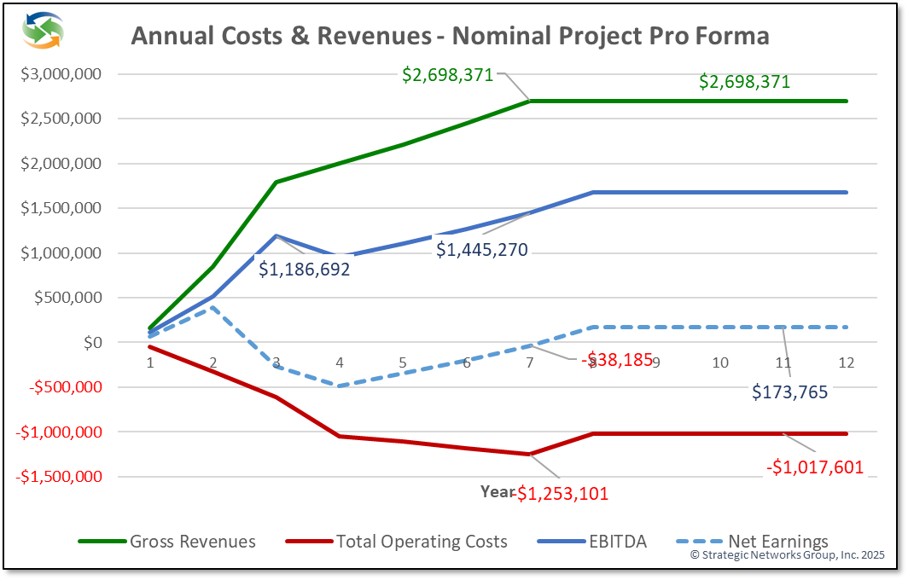
Option 2: BEAD Only
Serving only low-density, BEAD eligible locations
Cost: $51 million*
BEAD Grant request: $38 million*
Premises passed: 22,533
Subscribers: 2,939
Cash flow positive: 17 years
Cash flow breakeven: 19 years
*May change with BEAD rule changes
Long time to capital payback and potential revenue stream for County
Limited funding for expansion / network refresh / network promotion
Operational shortfalls for 17 years would need to be covered by financing

Slide 9
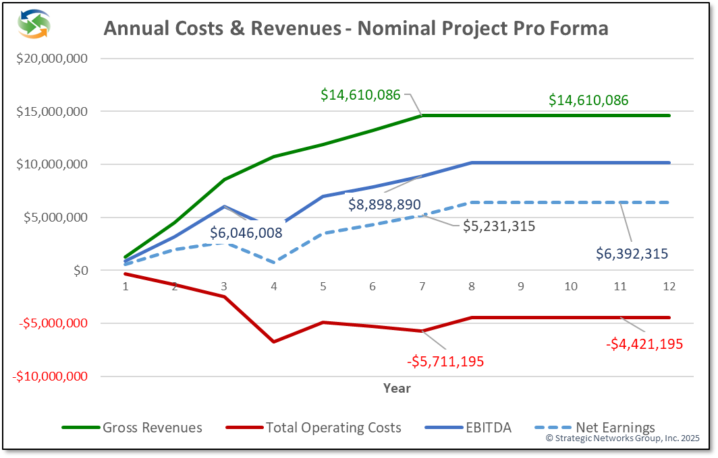
Option 3: BEAD + non-BEAD
Serving all locations, BEAD and non-BEAD eligible
Cost: $66 million*
BEAD Grant request: $38 million*
Premises passed: 22,533
Subscribers: 15,892
Cash flow positive: 1 year
Cash flow breakeven: 1 year
*May change with BEAD rule changes
Faster time to capital pay-off and revenue potential for County
Generates adequate funds for network expansion / equipment refresh / promotion
No operational shortfall, immediate cash flow positive

Slide 10
Option 4: CAI Ring Network
Move forward with Community Anchor Ring Network, not waiting on BEAD outcomes
Cost: $6.4 million (can help fulfill grant match requirements and improve chances of grant award)
Potential reach (minimum build): 71 CAIs, 1,697 Premises
Build necessary backbone ring – enables network redundancy and serves as foundation for future BEAD network
Get customer commitments, finance and build as revenue commitments meet financing and operating cost requirements
Provide CAIs with improved connectivity and cost savings
Maintain project momentum, build network brand, and demonstrate network performance ahead of BEAD
If BEAD does not materialize, CAI network still provides significant community benefits, and can expand over time to serve remaining underserved locations
First to market advantages:
Sign up customers before commercial entities offer promotions for long term contracts
Acquisition of equipment, materials, labor, etc. pre-BEAD rush
Will be seen as a regional leader / establishes network credibility, service and performance capabilities
With demonstrated operational history/experience, bond financing rates, for BEAD phase needs, will be lower

Slide 11
Network Financing and Governance
Models for Network Financing and Governance
Traditional – Municipal owned, financed, and controlled
  Financing impacts County’s financials
  County has control over network governance but changes to County Governance could have significant impact on network’s governance / survivability
  Limited shielding for taxpayers
63-20 – Non-profit financed and controlled
  Financing DOES NOT impact County’s financials
  County has input but not controlling seats on governance board
  Ownership of assets reverts to County at capital pay-off
  Preferred model for investors

Slide 12
Benefits of Community-owned Network
Local control of County’s digital future
County can make network decisions that promote local economic development
County focus on universal access vs. private focus on profit
Community-owned open-access model enables:
  Service provider competition vs. monopoly
  Increased take-rates for long-term network sustainability
Future new revenue stream for County: $6.4 million net earnings in Year 10
Option 3 Economic Impacts*
  *Note: with 5% business participation
New Jobs Created | 154
Increased Business Revenues | $119 million
Additional Income Taxes | $13 million
Additional GDP | $149 million

Slide 13
Direction from Board - Next Steps
Decision: Which Network Option(s) to continue to pursue?
What information would you like to see, moving forward?
Preferred Financing and Governance model

Slide 14


Thank You
Holly Miller
IT Director, Columbia County
+1 503.397.7240
Holly.Miller@columbiacountyor.gov
Michael Curri
President, Strategic Networks Group, Inc.
+1 202.558.2128
mcurri@sngroup.com

Slide 15
Structural Separation of Digital Infrastructure
Service Layer
Private service providers
(ISPs lease access to serve users)
ISPs with experience and technical expertise compete to provide services to users
Active (Electronics) Layer
Private network operator
(RSG Telecom)
Neutral operator brings technical knowledge and resources to partnership to efficiently operate and maintain network
Digital Infrastructure Layer
(physical fiber)
Owned by non-profit consortium of local stakeholders
With a large asset base already, PUDs and localities are setup to invest longer-term (15-20 years)
Delivery of services by private sector, with local stewardship over digital infrastructure

Slide 16
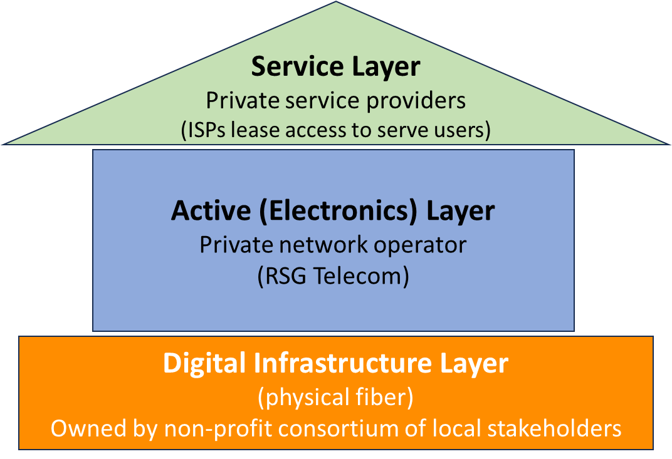
What’s the Vision?
A community-owned open-access network providing affordable, high-speed broadband to every premise and ensuring local control over Columbia County’s digital future.
What does this look like?
Structural separation of physical broadband infrastructure from network operations and internet service delivery with:
Non-profit ownership (local consortium) of broadband infrastructure
Private network operator contracted bringing their expertise to operate and maintain network 24/7/365
Multiple service providers use the digital infrastructure to provide choice of diverse services at competitive rates delivered to every premise
An economic development platform is created by the public and private sectors

Slide 17
Pros and Cons of County Financing Options
 | County Financing | Private Operator Financing | Non-Profit (non-government)
 | County finances network, with lien on network revenues | Private operator secures financing and becomes owner | Non-Profit finances network with ownership to County, lien on network revenues
Pros | County in control of network Community-owned network with focus on local economic development “Commercially Viable” portion of County network can enhance sustainability of “BEAD” portion Network net earnings = new revenue source for County Direct County ownership could result in lower interest rate on debt to finance network | Minimal work for Columbia County; private operator establishes according to its model | Community-owned network, but no operational nor financial responsibility of County Tax exempt financing; no public vote required because taxpayers “not on the hook” “Commercially Viable” portion of County network can enhance sustainability of “BEAD” portion Network net earnings new County revenue source Separate Governing Board administering Non-Profit includes County and key stakeholder leadership Individuals with business and telecommunication experience manage the Non-Profit
Cons | County is completely responsible for network Broadband network service or financial issues are County responsibility to resolve for network customers and debt holders As a County responsibility, future Commissioners could make decisions on network operations Setup and administration of County financing; financials roll into County’s budget and audit | Public funds pay for network, but ownership becomes private; if network is sold no County control over network, nor network expansion plans Private sector focuses on ROI rather than driving utilization and community benefits No ability to enhance sustainability of BEAD funded portion of network Higher fees to the network customers from: Higher interest rate paid on any debt financing because private operators cannot use tax-exempt financing Private owners expect an equity-type ROI | County influences, but does not control network

Slide 18
Pros and Cons of County Financing Options
 | County Financing | Private Operator Financing | Non-Profit (non-government)
 | County finances network, with lien on network revenues | Private operator secures financing and becomes owner | Non-Profit finances network with ownership to County, lien on network revenues
Pros | County in control of network Community-owned network with focus on local economic development “Commercially Viable” portion of County network can enhance sustainability of “BEAD” portion Network net earnings = new revenue source for County Direct County ownership could result in lower interest rate on debt to finance network | Minimal work for Columbia County; private operator establishes according to its model | Community-owned network, but no operational nor financial responsibility of County Tax exempt financing; no public vote required because taxpayers “not on the hook” “Commercially Viable” portion of County network can enhance sustainability of “BEAD” portion Network net earnings new County revenue source Separate Governing Board administering Non-Profit includes County and key stakeholder leadership Individuals with business and telecommunication experience manage the Non-Profit
Cons | County is completely responsible for network Broadband network service or financial issues are County responsibility to resolve for network customers and debt holders As a County responsibility, future Commissioners could make decisions on network operations Setup and administration of County financing; financials roll into County’s budget and audit | Public funds pay for network, but ownership becomes private; if network is sold no County control over network, nor network expansion plans Private sector focuses on ROI rather than driving utilization and community benefits No ability to enhance sustainability of BEAD funded portion of network Higher fees to the network customers from: Higher interest rate paid on any debt financing because private operators cannot use tax-exempt financing Private owners expect an equity-type ROI | County influences, but does not control network

Slide 19
Budget Estimate 2025
Connecting Columbia County
County Budget Estimate for 2025-26 (until network cashflow positive)
 |  | 2025 Budget | Reimbursed | County
 | Item |  | (BEAD, revenue bond)
 | Network Capital Investment | $5,000,000 | $5,000,000 | $0
1 | Letter of Credit/Performance Bond for BEAD application | $150,000 | $150,000 | $0
2 | Bond Financing (includes bond counsel, financing costs) | $170,000 | $170,000 | $0
3 | PPP and other agreements with network operator | $80,000 | $80,000 | $0
4 | Consortium agreement with local stakeholders | $25,000 |  | $25,000
5 | Owner's representative / project management | $140,000 | $140,000 | $0
6 | Market Data Collection and Network Sign-up | $125,000 | $125,000 | $0
7 | Network Promotion and Driving Utilization | $120,000 |  | $120,000
8 | Additional financial modeling and SNG assistance* | $50,000 | $40,000 | $10,000
 | Total | $860,000 | $705,000 | $155,000
 | *Note: requires Commission resolution
*Draft Commission Resolution: It is the intent of the Columbia County commission that any expenditures made by the County to create the broadband utility should be reimbursed to the County from any financing arranged by the broadband utility.

Slide 20
Budget Considerations
Revenue bond financing - reimbursable costs
Construction capital
Capitalized interest
Bond financing
Broadband market study and project preparation
Owner's project management
Network design, maps
Insurance / performance bond

Slide 21
Columbia County Financial Modeling

Slide 22
SandyNet Advisory Board
The purpose of the SandyNet Advisory Board is to advise the City Council on the operations, long-term strategy, growth, and scope of services offered by SandyNet, the City’s municipal telecommunications utility, to meet the current and future needs of Sandy and the greater service area.
No more than two Board Members may reside outside of the city limits of the City of Sandy. All Board Members must reside within the boundaries of the Oregon Trail School District.

