Slide 1

Activity-based Maintenance Workplan
Columbia County Public Works Department

Slide 2
Why are we considering this now?
Looking at our current funding levels and projecting those out over the next 5 years:
Assumptions:
There will be no additional new revenue
Costs will continue to increase consistent with historic and current trends
Try to provide at least current level of service
Avoid elimination of currently filled positions
Eliminate currently vacant positions
Spend down Road Fund Reserves
Maintain at least $1 million in reserves for disaster

Slide 3
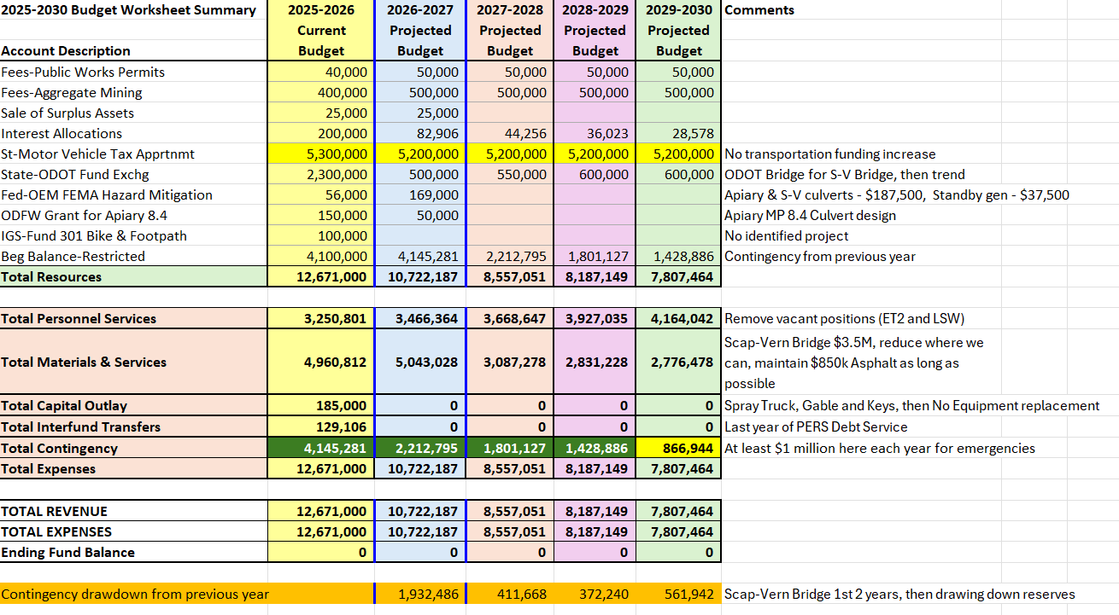

Slide 4
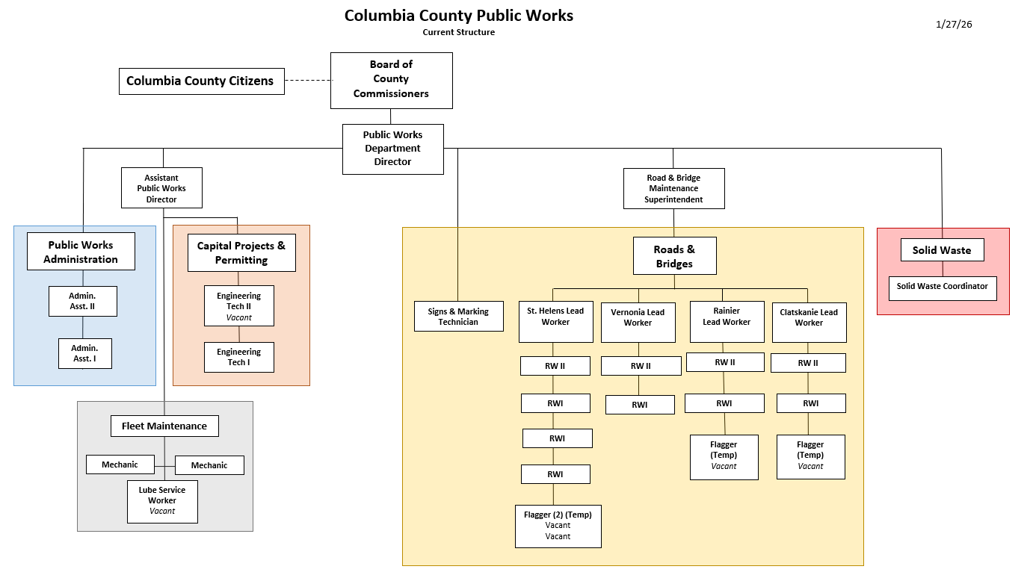
Management – 3
Admin. Support – 4
Fleet – 3
Road Maint. – 15
Solid Waste - 1
TOTAL 26

Slide 5
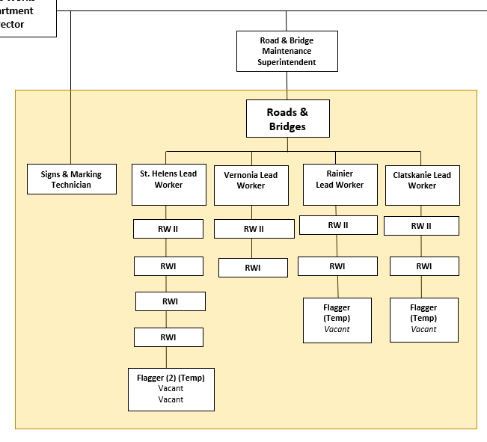
CURRENT

Slide 6
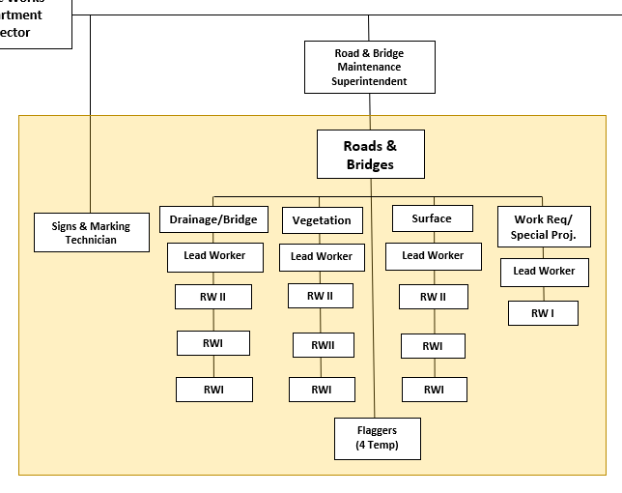
Drainage/Bridge
Ditching
Digouts
Culverts
Prep for paving
Bridge Work
Guardrail
Vegetation:
Mowing
Spraying
Wood Chipping
Surface:
Paving/Chip Seal
Grading
Rocking
Work Requests/ Special Projects:
Priority Work Requests
Pothole repair
Floating as needed
PROPOSED

Slide 7
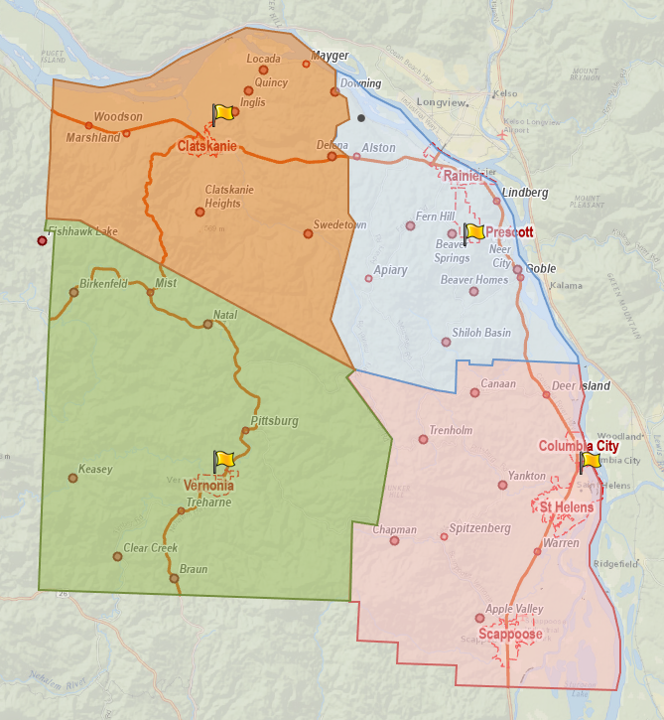
Current Operations
Road maintenance broken out by district
Four district shops:
District I-Saint Helens
District II-Rainier
District III-Vernonia
District IV-Clatskanie

Slide 8
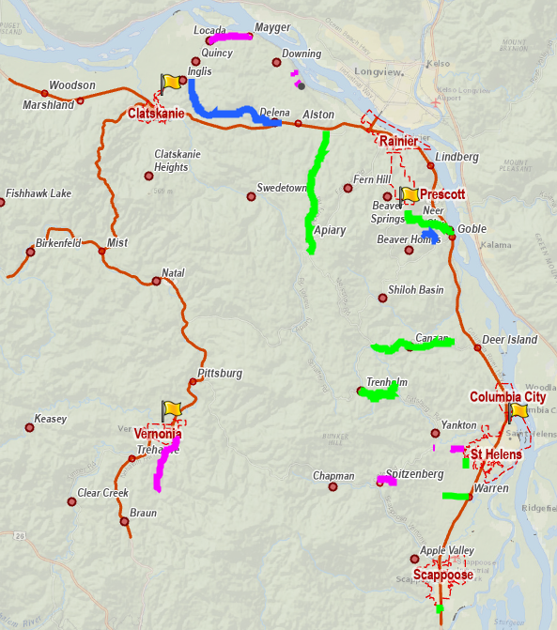
2026 Work Plan – Surface and Ditching
Road # | Road Name | From | To
 | Prep for Pave
3060 | Pebble Creek Road | McDonald | Alder
1150 | Sykes Road | City limits | East Kappler
1150 | Sykes Road | West Kappler | Brooks
1030 | Cater Road (2 sect.) | Walker | Alder Cr
2001 | Alston Mayger Road | Tie in patches
4134 | Quincy Mayger Road | Kalunki | Mayger Fill
 | Prep for Chip Seal
2090 | Neer City Road | Hwy 30 | Brownlee
1128 | Pittsburg Road | water shed | South Canaan
2005 | Apiary Road | Old Rainier | Meissner
1029 | Canaan Road | Lawrence | Meissner
1118 | Old Portland Road | Callahan | Bonneville
1036 | Church Road | Hwy 30 | Hazen
1137 | Ross Road | Bachelor Flat | Millard
 | Ditch
4147 | Old Beaver Falls Road | Hwy 30 | Quincy May.
2017 | Bishop Road | Nick Thomas | Nicolai

Slide 9
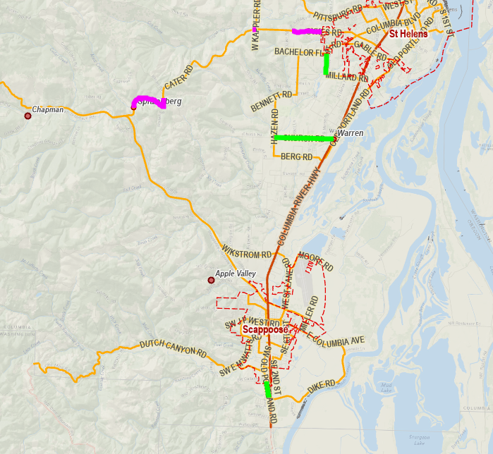
2026 Work Plan – Surface and Ditching, Scappoose Area
Road # | Road Name | From | To
 | Prep for Pave
3060 | Pebble Creek Road | McDonald | Alder
1150 | Sykes Road | City limits | East Kappler
1150 | Sykes Road | West Kappler | Brooks
1030 | Cater Road (2 sect.) | Walker | Alder Cr
2001 | Alston Mayger Road | Tie in patches
4134 | Quincy Mayger Road | Kalunki | Mayger Fill
 | Prep for Chip Seal
2090 | Neer City Road | Hwy 30 | Brownlee
1128 | Pittsburg Road | water shed | South Canaan
2005 | Apiary Road | Old Rainier | Meissner
1029 | Canaan Road | Lawrence | Meissner
1118 | Old Portland Road | Callahan | Bonneville
1036 | Church Road | Hwy 30 | Hazen
1137 | Ross Road | Bachelor Flat | Millard
 | Ditch
4147 | Old Beaver Falls Road | Hwy 30 | Quincy May.
2017 | Bishop Road | Nick Thomas | Nicolai

Slide 10
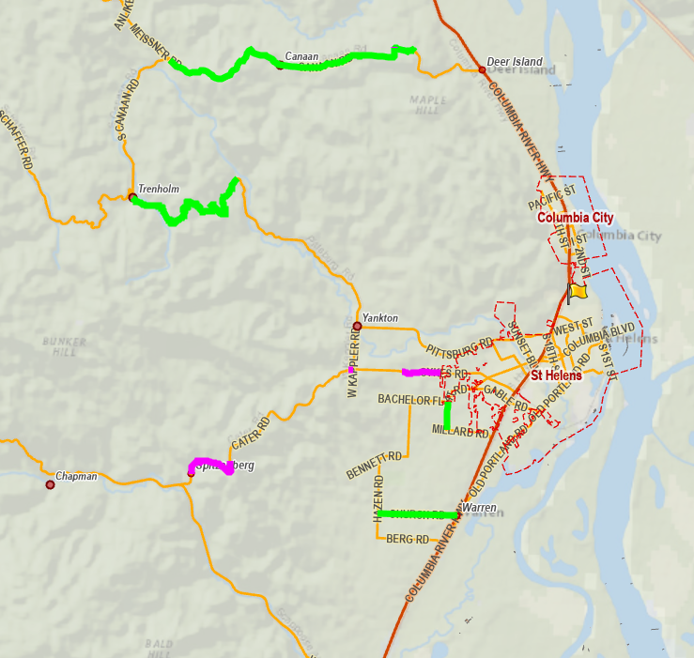
2026 Work Plan – Surface and Ditching, Saint Helens Area
Road # | Road Name | From | To
 | Prep for Pave
3060 | Pebble Creek Road | McDonald | Alder
1150 | Sykes Road | City limits | East Kappler
1150 | Sykes Road | West Kappler | Brooks
1030 | Cater Road (2 sect.) | Walker | Alder Cr
2001 | Alston Mayger Road | Tie in patches
4134 | Quincy Mayger Road | Kalunki | Mayger Fill
 | Prep for Chip Seal
2090 | Neer City Road | Hwy 30 | Brownlee
1128 | Pittsburg Road | water shed | South Canaan
2005 | Apiary Road | Old Rainier | Meissner
1029 | Canaan Road | Lawrence | Meissner
1118 | Old Portland Road | Callahan | Bonneville
1036 | Church Road | Hwy 30 | Hazen
1137 | Ross Road | Bachelor Flat | Millard
 | Ditch
4147 | Old Beaver Falls Road | Hwy 30 | Quincy May.
2017 | Bishop Road | Nick Thomas | Nicolai

Slide 11
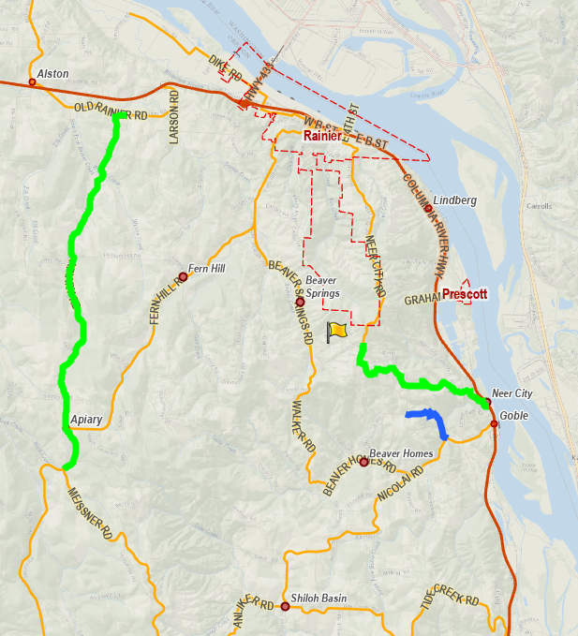
2026 Work Plan – Surface and Ditching, Rainier Area
Road # | Road Name | From | To
 | Prep for Pave
3060 | Pebble Creek Road | McDonald | Alder
1150 | Sykes Road | City limits | East Kappler
1150 | Sykes Road | West Kappler | Brooks
1030 | Cater Road (2 sect.) | Walker | Alder Cr
2001 | Alston Mayger Road | Tie in patches
4134 | Quincy Mayger Road | Kalunki | Mayger Fill
 | Prep for Chip Seal
2090 | Neer City Road | Hwy 30 | Brownlee
1128 | Pittsburg Road | water shed | South Canaan
2005 | Apiary Road | Old Rainier | Meissner
1029 | Canaan Road | Lawrence | Meissner
1118 | Old Portland Road | Callahan | Bonneville
1036 | Church Road | Hwy 30 | Hazen
1137 | Ross Road | Bachelor Flat | Millard
 | Ditch
4147 | Old Beaver Falls Road | Hwy 30 | Quincy May.
2017 | Bishop Road | Nick Thomas | Nicolai

Slide 12
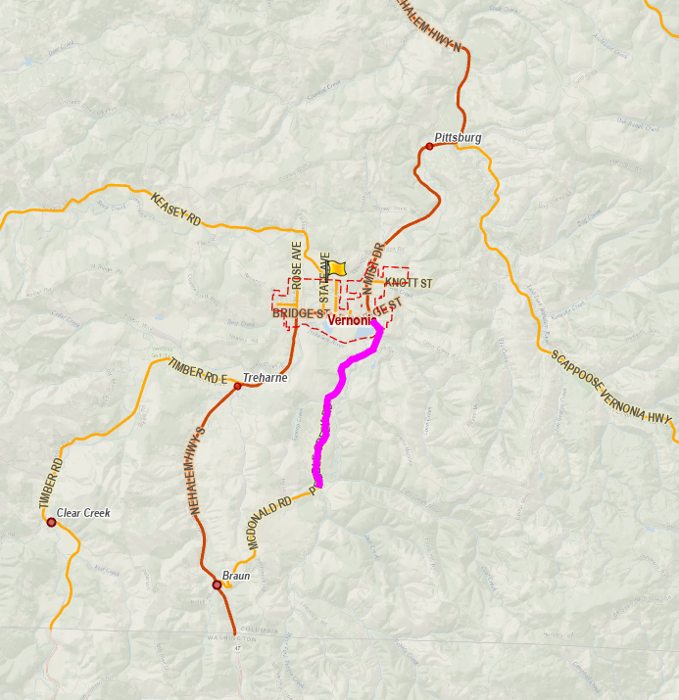
2026 Work Plan – Surface and Ditching, Vernonia Area
Road # | Road Name | From | To
 | Prep for Pave
3060 | Pebble Creek Road | McDonald | Alder
1150 | Sykes Road | City limits | East Kappler
1150 | Sykes Road | West Kappler | Brooks
1030 | Cater Road (2 sect.) | Walker | Alder Cr
2001 | Alston Mayger Road | Tie in patches
4134 | Quincy Mayger Road | Kalunki | Mayger Fill
 | Prep for Chip Seal
2090 | Neer City Road | Hwy 30 | Brownlee
1128 | Pittsburg Road | water shed | South Canaan
2005 | Apiary Road | Old Rainier | Meissner
1029 | Canaan Road | Lawrence | Meissner
1118 | Old Portland Road | Callahan | Bonneville
1036 | Church Road | Hwy 30 | Hazen
1137 | Ross Road | Bachelor Flat | Millard
 | Ditch
4147 | Old Beaver Falls Road | Hwy 30 | Quincy May.
2017 | Bishop Road | Nick Thomas | Nicolai

Slide 13
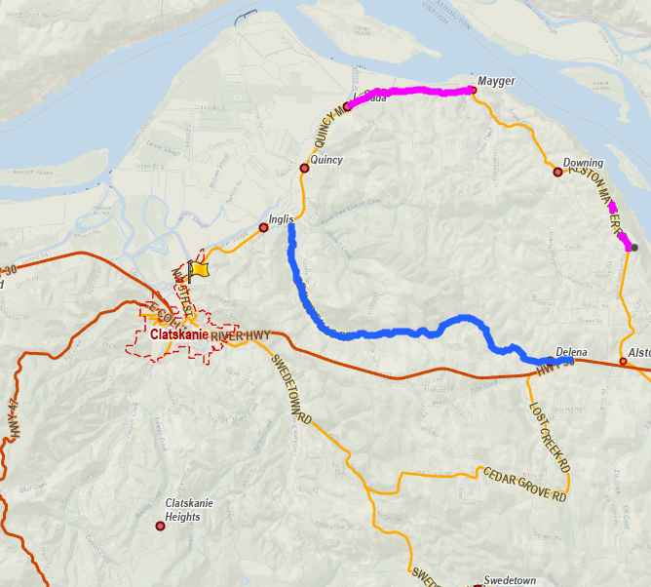
2026 Work Plan – Surface and Ditching, Clatskanie Area
Road # | Road Name | From | To
 | Prep for Pave
3060 | Pebble Creek Road | McDonald | Alder
1150 | Sykes Road | City limits | East Kappler
1150 | Sykes Road | West Kappler | Brooks
1030 | Cater Road (2 sect.) | Walker | Alder Cr
2001 | Alston Mayger Road | Tie in patches
4134 | Quincy Mayger Road | Kalunki | Mayger Fill
 | Prep for Chip Seal
2090 | Neer City Road | Hwy 30 | Brownlee
1128 | Pittsburg Road | water shed | South Canaan
2005 | Apiary Road | Old Rainier | Meissner
1029 | Canaan Road | Lawrence | Meissner
1118 | Old Portland Road | Callahan | Bonneville
1036 | Church Road | Hwy 30 | Hazen
1137 | Ross Road | Bachelor Flat | Millard
 | Ditch
4147 | Old Beaver Falls Road | Hwy 30 | Quincy May.
2017 | Bishop Road | Nick Thomas | Nicolai

Slide 14
2026 Work Plan – Brush Cutting
Brush cutting is different from routine mowing
Pull vegetation back from road edge to create clear zone
Once established, routine mowing maintains clear zone
  Some areas need more frequent brush cutting based on fast-growing vegetation (blackberries, etc.)
  In those cases, may see more frequent or different treatment

Slide 15
2026 Work Plan – Brush Cutting –
Saint Helens Area
Road # | Road Name | From | To | Miles
1011 | Barger | Gensman | dead end | 0.68
1029 | Canaan | Hwy 30 | Meisner | 6.69
1030 | Cater | Sykes | Scap Vern | 4.56
1036 | Church | Hwy 30 | end CO maint. | 2.38
1045 | Dart Creek | Gensman | Smith | 2.06
1056 | Firlock Park | Gable | Maple | 0.27
1128 | Pittsburg | water shed | S. Canaan | 2.51
1117 | Oester | Hazen | dead end | 0.80
1118 | Old Porltand | Callahan | Bonneville | 0.35
1137 | Ross | Bachelor Flat | Millard | 0.50
1147 | Smith | city limit (CC) | gate | 5.26
1149 | Stone | Hazen | Cater | 2.00
1150 | Sykes | city limit (SH) | Cater | 2.05
1169 | Viewcrest | Oester | dead end | 0.79
1050 | Dutch Canyon | Old Portland | gate | 4.80
 |  |  | Total | 35.70
Total miles: 35.70

Slide 16
2026 Work Plan – Brush Cutting –
Rainier Area
Road # | Road Name | From | To | Miles
2001 | Alston | for paving |  | 1.00
2005 | Apiary | Old Rainier | Meissner | 7.00
2031 | Debast | Fern Hill | J Street | 3.17
2054 | Goble School | Nicolai Cutoff | Nicolai | 0.13
2059 | Hammond | Fern Hill | dead end | 1.22
2061 | Highland | Orr | Tide Creek | 1.71
2070 | Jaquish | Nicolai Cutoff | Wilbur | 0.59
2090 | Neer City | Hwy 30 | Brownlee | 3.30
2092 | Nicolai | Hwy 30 | Tide Creek | 6.23
2098 | Orr | Tide Creek | Nicolai | 1.52
2110 | Tide Creek | Hwy 30 | Bishop Creek | 6.02
 |  |  | Total | 31.89
Total miles: 31.89

Slide 17
2026 Work Plan – Brush Cutting –
Vernonia Area
Road # | Road Name | From | To | Miles
3074 | Timber | county line | Hwy 47 | 7.49
3034 | Fishhawk | Hwy 202 | gate | 3.81
3051 | McDonald | Hwy 47 | Pebble Creek | 1.07
3060 | Pebble Creek | Alder | McDonald | 5.24
 |  |  | Total | 17.61
Total miles: 17.61

Slide 18
2026 Work Plan – Brush Cutting –
Clatskanie Area
Road # | Road Name | From | To | Miles
4134 | Quincy Mayger | Kalunki | Delena Mayger | 4.53
4186 | Stewart Creek | Quincy Mayger | Rutters | 4.72
4137 | Olson | Swedetown | dead end | 2.92
4023 | Delena Mayger | Beaver Falls | Alston Mayger | 3.43
4060 | Ilmari | Quincy Mayger | Stewart Creek | 2.48
4105 | Lost Creek | Hwy 30 | Elk Creek | 5.68
4013 | Cedar Grove | Lost Creek | Swedetown | 3.48
 |  |  | Total | 27.24
Total miles: 27.24

Slide 19
2026 Work Plan – Culvert Replacement
RD # | Road | Location
1026 | Cater Hill Rd | 300ft from Cater
1045 | Dart Creek Rd | cross tile
1073 | Hankey Rd | just before Perry Creek
1117 | Oester Rd | Just passed 33251
1128 | Pittsburg Rd | french drain
1136 | Robinette Rd | 61051
1143 | Scappoose-Vernonia Rd | at 31037
1146 | EJ Smith Rd | over Alder Creek
2019 | Baldwin Rd | at Warren; crushed on both ends; flooded this year
2033 | Doan Rd | double below trailer park
3001 | Apiary Rd 3
3052 | Mellinger Rd | driveway culvert and ditch
3060 | Pebble Creek Rd 2
RD # | Road | Location
4016 | Co Op Rd | 2nd cross culvert (metal)
4016 | Co Op Rd | both pipes @ bottom @ Beaver Falls inter.
4016 | Co Op Rd | 1st cross culv. up hill past narrow sect (metal)
4023 | Delena Mayger Rd | cross tile @ Mosier outflow (smashed)
4023 | Delena Mayger Rd | 300' from Alston Mayger
4024 | Depot St | cross tile @ RR
4089 | Clatskanie Heights Rd | midway up on paved portion (hill)
4105 | Lost Creek Rd | gravel sect. at Winslow; large cross culvert failing (metal)
4105 | Lost Creek Rd | next one up from Winslow
4105 | Lost Creek Rd | 400 ft below sharp corner
4147 | Beaver Falls Rd | at Mustola
4150 | Colvin Rd | at Tandy Creek bridge overflow pipe
4186 | Stewart Creek Rd | 500 above Ilmari
4190 | Swedetown Rd | cross tile @ Cedar Grove 12" upgrade
4190 | Swedetown Rd | cross tile @ Cedar Grove pull out side 15" rotting
Total culverts to be replaced: 28
District I: 8
District II: 2
District III: 3
District IV: 15

Slide 20
2026 Work Plan – Striping, Spraying, Grading
All applicable County-maintained roads
  Striping – all centerline, fog line striping on County roads
    Determined by classification, road width
  Spraying – application of herbicide along County roads
    “No-spray” agreements are available for those who would rather maintain road edge themselves
  Grading – rocking, grading County gravel roads

Slide 21
2026 Work Plan - alternatives
Public Works management believes this activity-based workplan represents the best approach to efficiently using road fund dollars
If not moving in this proactive direction, recommend retaining the status quo
Leaving crews in current districts
  Limited crew size reduces ability to address multiple issues at once
  Can borrow equipment, crew from other district, but then what happens to that district?
Basing activity-based crews out of remote shops
  Lose agility in determining crew composition, addressing replacements for absences
  Mobilization times still a factor

