Slide 1
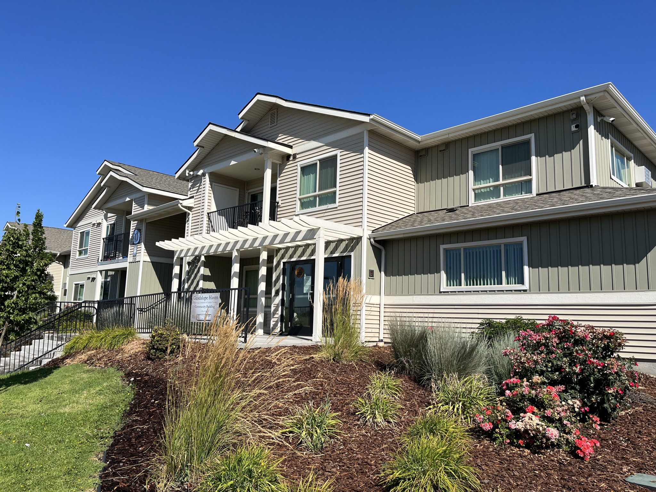
Othello
Multifamily Tax Exemption Program Study
Presented to:
Othello Planning Commission
September 19, 2022
Notes:
Line spacing + Page numbers

Slide 2
Agenda
01 Housing Action Plan
02 What is the MFTE Program
03 Tax benefits and impacts
04 Considerations in adopting
05 Questions and discussion

Slide 3
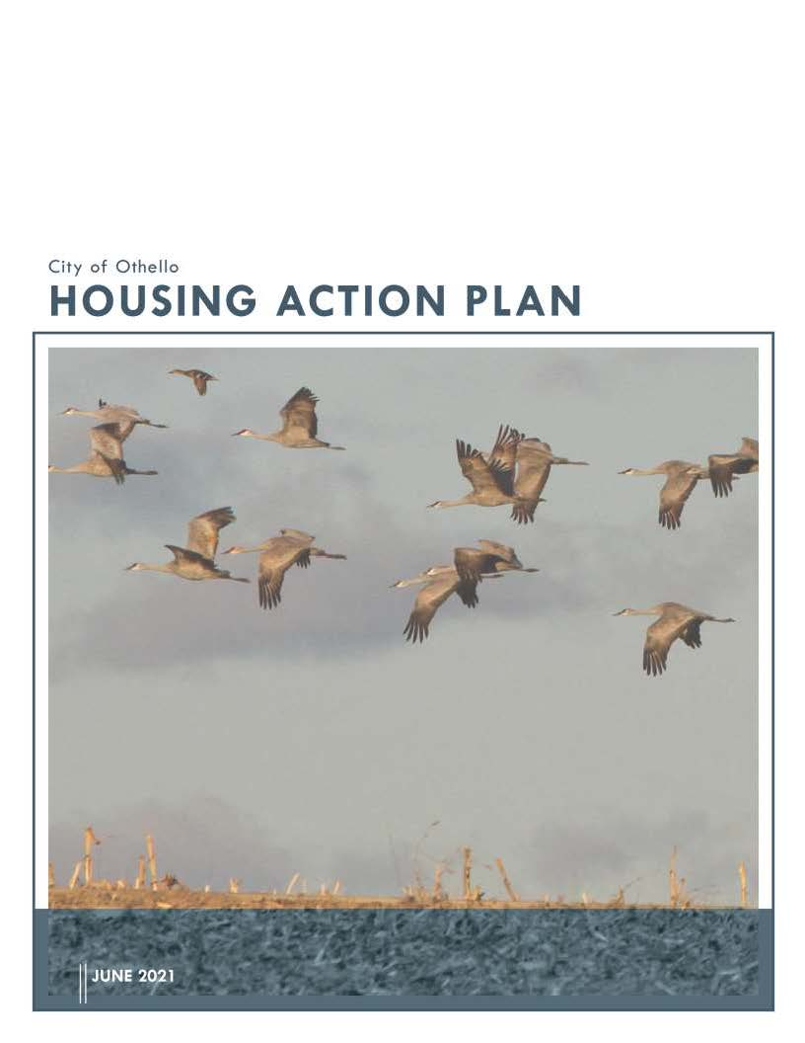
Housing Action Plan
01
Four strategies recommended:
Revise Zoning and Building Standards
Parking and Transportation Standards
Affordable Housing Incentives
Process Improvements
“Explore the use of a Multifamily Tax Exemption (MFTE) program for affordable housing”

Slide 4
What is the Multifamily Tax Exemption (MFTE) Program?
02

Slide 5
MFTE Overview
First created in 1995; available to Othello in 2021
This is a property tax exemption
Tax exemption is for 12- or 20-years, depending on program
Applies to new construction, conversion, and rehabilitation of multifamily residential improvements; does not apply to land or non-residential improvements
Must create at least 4 new units of housing
20% of the units must be affordable to low- and moderate-income households
The remaining 80% can be market rate but still receive property tax exemption
City must designate target areas for where incentive can be used

Slide 6
12- and 20-year programs
12-year program:
  Create at least 4 units
  20% set aside for low- and moderate-income households
  Remaining 80% can be market rate housing
20-year program:
  Create at least 4 units
  Sell at least 25% of the units to a qualified nonprofit or local government
    These units must be assured to be permanent affordable homeownership
  Remaining 75% of units can be rented or sold at market rate

Slide 7
Key Definitions
Low-income household
Persons living together in a household
Income is at or below 80% of median family income adjusted for family size
Moderate-income Household
Persons living together in a household
Income is more than 80% but is at or below 115% of median family income adjusted for family size
Affordable housing
Monthly housing costs, including utilities, do not exceed 30% of household income

Slide 8
Income Limits (2022)
 | Household Size
 | 1 PERSON | 2 PERSONS | 3 PERSONS | 4 PERSONS | 5 PERSONS | 6 PERSONS | 7 PERSONS | 8 PERSONS
80% AMI (Low Income) | 44,240 | 50,560 | 56,880 | 63,120 | 68,240 | 73,280 | 78,320 | 83,360
100% AMI | 55,300 | 63,200 | 71,100 | 78,900 | 85,300 | 91,600 | 97,900 | 104,200
115% AMI (Moderate Income) | 63,595 | 72,680 | 81,765 | 90,735 | 98,095 | 105,340 | 112,585 | 119,830

Slide 9
Rent Limits (2022)
Income | Bedrooms (People)
 | Efficiency (1.0) | 1 Bedroom (2.0) | 2 Bedrooms (3.0) | 3 Bedrooms (4.0) | 4 Bedrooms (5.0)
80% AMI (Low Income) | 1,106 | 1,264 | 1,422 | 1,578 | 1,706
100% AMI | 1,382 | 1,580 | 1,777 | 1,972 | 2,132
115% AMI (Moderate Income) | 1,589 | 1,817 | 2,044 | 2,268 | 2,452

Slide 10
Market Rents (Snapshot)
Source: | Bedrooms (People)
 | Efficiency (1.0) | 1 Bedroom (2.0) | 2 Bedrooms (3.0) | 3 Bedrooms (4.0) | 4 Bedrooms (5.0)
RE/MAX Northwest Realtors - Othello | - | 1,000 | 1,031 | 1,347 | 1,066
Housing Action Plan | - | - | 1,038 | 1,314 | -

Slide 11
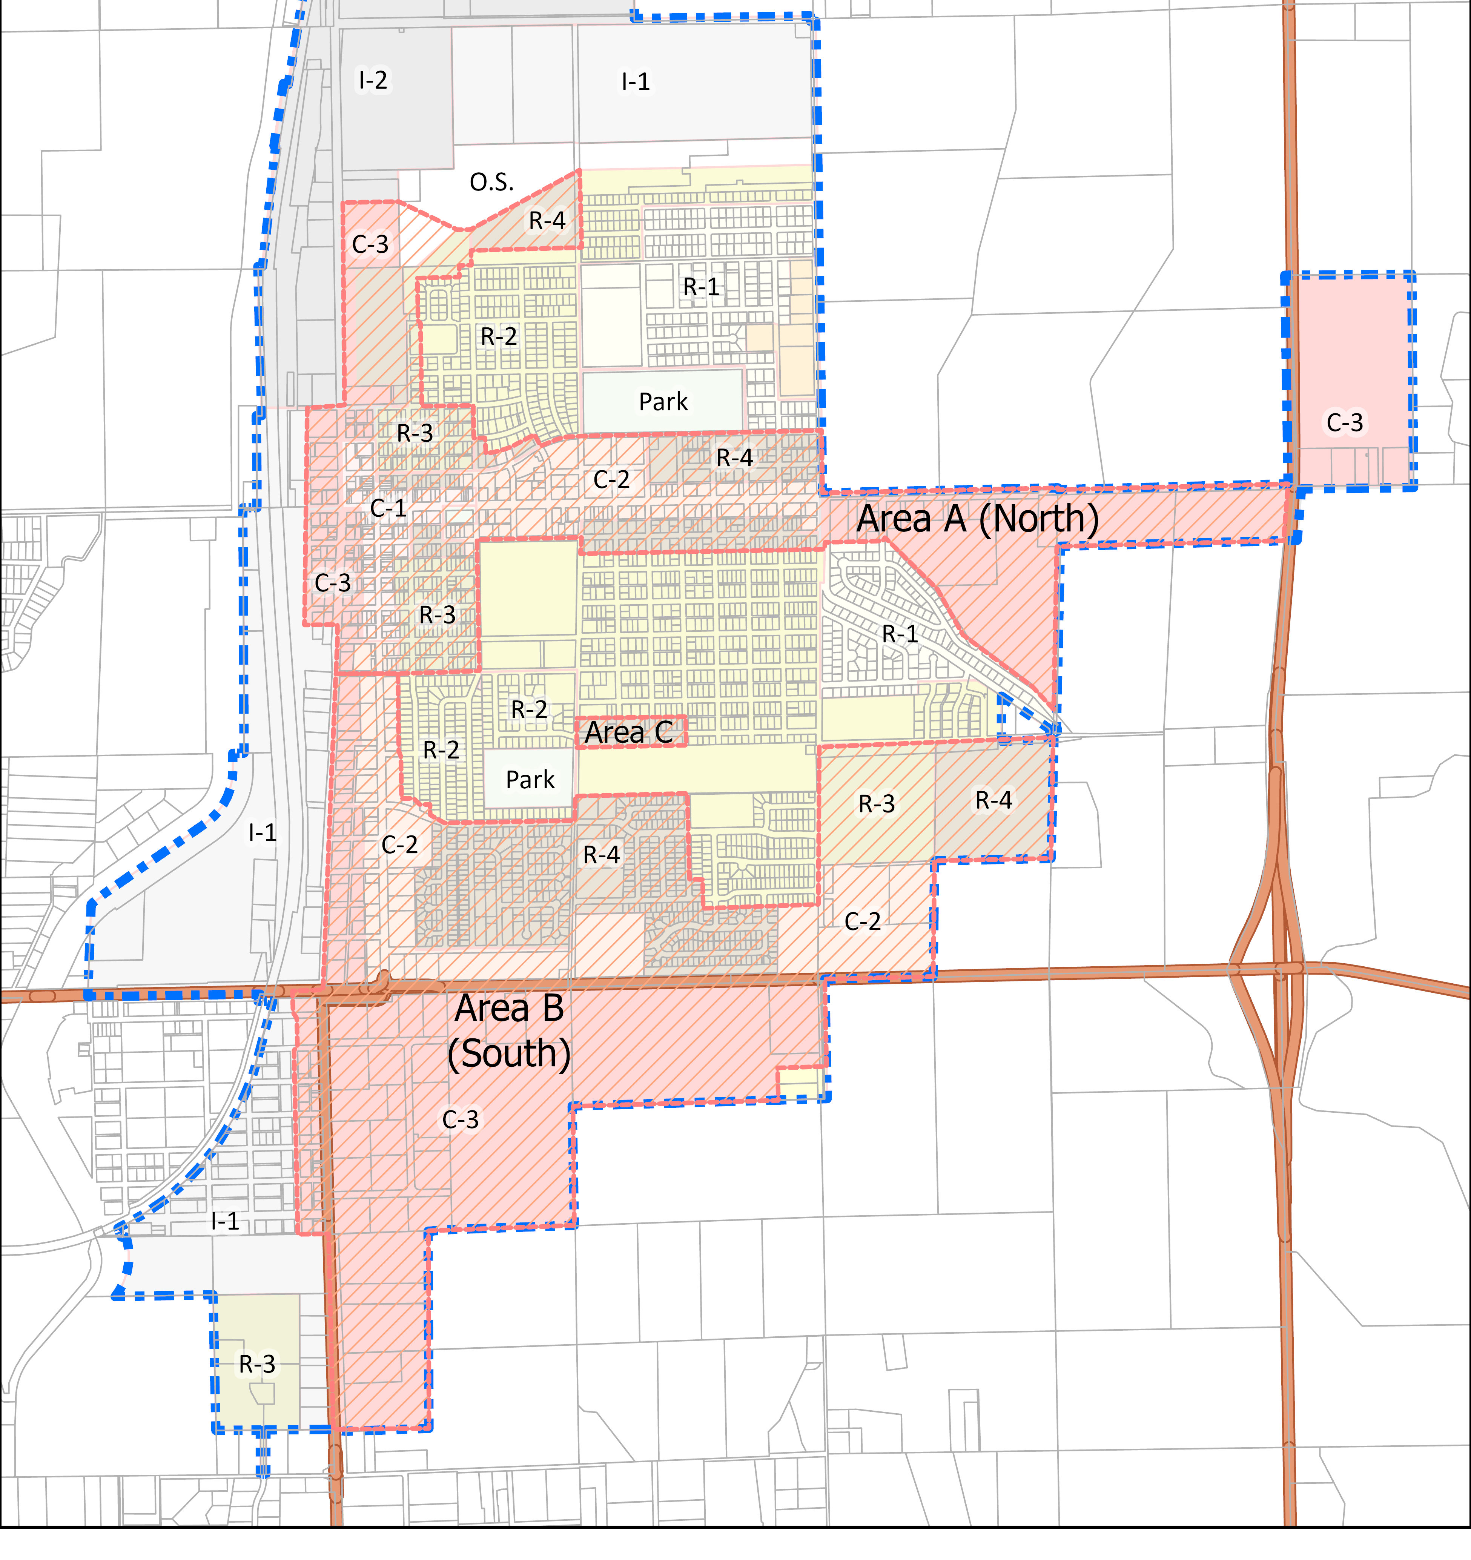
Where allowed
Must allow multifamily
Compact district with:
  Business establishments
  Adequate public facilities
  Mixture of uses and activities
Must allow a minimum of 15 units per gross acre

Slide 12
Tax benefits and impacts
03

Slide 13
Tax Benefits
For the Owner/Developer:
Value of new improvements not added to property tax rolls for 12- or 20-years
Current levy is $12.66 per $1,000 of assessed value
Example:
  $2 million in new construction would save $25,327 in 2022 or
  $321,212 over 12 years
Land and non-residential improvements remain on tax rolls
For the City:
Sales tax on new housing construction
Example:
  $2 million in new construction would collect $31,800 in sales tax
Catalyst for other development
Close proximity to business
Housing to meet community needs

Slide 14
Tax Impacts
Value of new construction is not added to the property tax rolls
No reduction in amount collected but no increase, either
All property tax districts won’t see gains from new construction until end of 12- or 20-year period
Taxing districts include schools, county, hospital, library, EMS, Port and Parks and Recreation

Slide 15
What should be considered?
04
Should this program move forward? Are the incentives necessary? Do the benefits outweigh the impacts? | Residential Target Area What areas should receive the incentive?
Affordable Housing Targets Should the state minimums be used or more targeted requirements for lower-incomes | Development Guidelines-Standards Should existing city standards be used? Or should there be additional requirements?
Approving Authority Who should approve projects if they meet requirements?

Slide 16
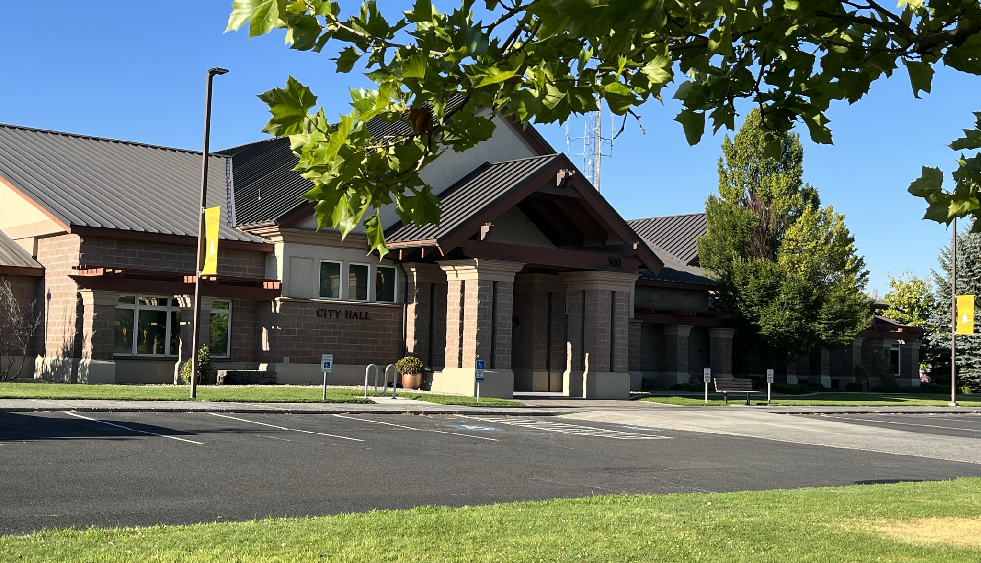
Questions-Discussion
05

