Slide 1
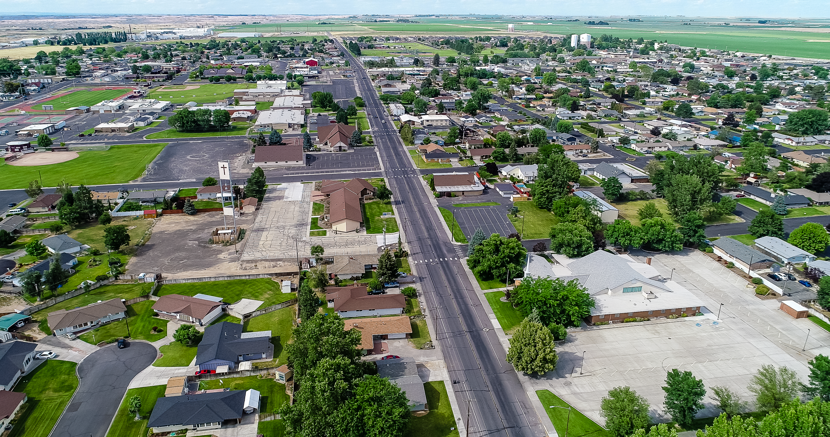

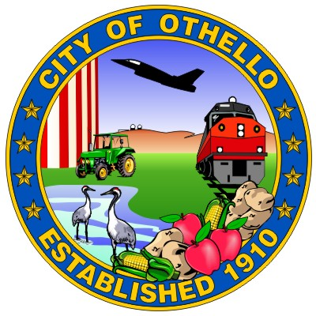

Othello Comprehensive Plan
Vision Statement Workshop
April 20, 2026

Slide 2
Today's Agenda
Overview
01
What We Heard
Key themes from the February 2026 visioning workshop
02
Tensions & Tradeoffs
Areas where priorities may compete
03
Baseline Vision Review
Draft vision statement walkthrough/thoughts
04
Alternative Directions
Row-by-row table discussion
05
Direction & Next Steps
Confirm priorities, refine the vision
Othello Comprehensive Plan Update | April 20, 2026

Slide 3






Six Key Themes from the February Workshop
What We Heard
People Define Othello
Growth Should Be Intentional
Housing & Affordability
Welcoming, close-knit, and culturally vibrant. Strong multi-generational roots and sense of belonging.
Transitioning from small town to small city, development should feel coordinated and connected.
Need for more housing options for families, seniors, and the local workforce.
Infrastructure Is Essential
Economic Opportunity
Quality of Life Matters
Long-term growth depends on reliable water, sewer, and public services.
Agriculture remains central, but strong desire to diversify jobs and support local businesses.
Parks, youth opportunities, events, and community spaces are essential to long-term livability.
Othello Comprehensive Plan Update | April 20, 2026

Slide 4
Four Key Tensions for Discussion
Tensions & Tradeoffs
Small-Town Character vs. Growth & Opportunity
Agricultural Identity vs. Economic Diversification
Discussion Prompt:
Discussion Prompt:
What aspects of Othello's character are essential to preserve, and what changes are acceptable as the city grows?
How should Othello balance preserving its agricultural foundation with attracting new types of development?
Housing Diversity vs. Neighborhood Character
Development Ambitions vs. Infrastructure Reality
Discussion Prompt:
Discussion Prompt:
Where and how should new housing types be integrated into the community?
How should infrastructure shape the pace and location of growth? Does development pay for development?
Othello Comprehensive Plan Update | April 20, 2026

Slide 5
Baseline Vision
Baseline Vision Statement
Draft framework informed by Planning Commission input

Slide 6
Vision Statement
Baseline Vision
Othello is a welcoming rural city where agriculture, culture, and community remain at the heart of daily life. Through thoughtful and coordinated growth, expanded housing opportunities, strong local businesses, and vibrant parks and public spaces, Othello continues to be a place where residents, families, and visitors thrive.
Vision covers eight topic areas:
Community Character
Land Use
Housing
Transportation
Utilities & Services
Parks & Recreation
Economic Development
Environmental Resilience
Othello Comprehensive Plan Update | April 20, 2026

Slide 7
Alternative Directions
Alternative Vision Directions
Work through the options, row by row, together

Slide 8
Exploring Alternatives
Alternative Directions
Baseline Vision
Growth & Opportunity
Character & Livability
The starting draft, grounded in February workshop input. Use this as the anchor for discussion.
Leans into city expansion, regional importance, economic growth, and proactive infrastructure investment.
Leans into identity, steady growth, neighborhood compatibility, and everyday quality of life.
How we'll run the exercise:
1. We'll review each of the eight topic areas row by row.
2. For each row, discuss: Which direction resonates — or is a hybrid better?
3. We will synthesize discussion into a refined vision after the meeting.
Othello Comprehensive Plan Update | April 20, 2026

Slide 9
Topic: Community Character
Alternative Directions
Baseline Vision
Growth & Opportunity
Character & Livability
Notes /
Hybrid
Othello remains a welcoming and close-knit community where diverse cultures, traditions, and generations of families shape the city's identity. As the city grows, it preserves its friendly atmosphere, strong sense of belonging, and rural heritage.
Othello continues to be a welcoming and inclusive community while evolving into a growing regional center. New residents, businesses, and industries reshape the community while maintaining a shared sense of identity.
Othello preserves its identity as a welcoming, close-knit, and culturally rich rural community, where relationships, traditions, and a strong sense of belonging remain the foundation of daily life.
Record preferred direction or hybrid language here during discussion.
Othello Comprehensive Plan Update | April 20, 2026

Slide 10
Topic: Land Use
Alternative Directions
Baseline Vision
Growth & Opportunity
Character & Livability
Notes /
Hybrid
Othello manages growth to protect surrounding farmland and rural character while supporting well-planned development. New neighborhoods and businesses are coordinated with infrastructure, reinforce a strong business district, and create connected, cohesive development patterns.
Othello actively plans for growth by expanding residential, commercial, and industrial areas in strategic locations, while also incentivizing medium and higher density infill projects.
Othello carefully manages growth to maintain rural character, protect farmland, and ensure new development reflects the scale and feel of existing neighborhoods.
Record preferred direction or hybrid language here during discussion.
Othello Comprehensive Plan Update | April 20, 2026

Slide 11
Topic: Housing
Alternative Directions
Baseline Vision
Growth & Opportunity
Character & Livability
Notes /
Hybrid
Othello provides a wide range of housing options that allow residents of all ages and incomes to live in the community. Diverse housing types support families, seniors, and the local workforce while being thoughtfully integrated into existing neighborhoods.
Othello's housing supply is robust, allowing expansion and density to meet demand and support economic growth. Multifamily, workforce housing, and higher-density development are encouraged in key areas throughout the City.
Othello expands housing options in a measured and context-sensitive way, prioritizing neighborhood compatibility, long-term affordability, and stability for current residents.
Record preferred direction or hybrid language here during discussion.
Othello Comprehensive Plan Update | April 20, 2026

Slide 12
Topic: Transportation
Alternative Directions
Baseline Vision
Growth & Opportunity
Character & Livability
Notes /
Hybrid
Othello maintains a safe and efficient transportation network that connects neighborhoods, schools, parks, and businesses. Expanded sidewalks, trails, and roadway improvements support safe and accessible travel for all users.
Othello invests in a transportation system that supports increased traffic, freight movement, and regional connectivity, including improvements to key corridors and highway access.
Othello prioritizes local connectivity, walkability, and neighborhood safety, with a focus on safe routes to schools, parks, and daily destinations.
Record preferred direction or hybrid language here during discussion.
Othello Comprehensive Plan Update | April 20, 2026

Slide 13
Topic: Utilities & Public Services
Alternative Directions
Baseline Vision
Growth & Opportunity
Character & Livability
Notes /
Hybrid
Othello provides reliable and modern infrastructure that supports responsible growth and a high quality of life. Water, sewer, broadband, schools, and public services are expanded in alignment with development.
The City pursues major, proactive investments in water, sewer, and infrastructure systems to unlock growth capacity and support long-term expansion.
Othello aligns growth with available infrastructure capacity, ensuring that development does not outpace water, sewer, and public service systems.
Record preferred direction or hybrid language here during discussion.
Othello Comprehensive Plan Update | April 20, 2026

Slide 14
Topic: Parks & Recreation
Alternative Directions
Baseline Vision
Growth & Opportunity
Character & Livability
Notes /
Hybrid
Othello offers a connected system of parks, recreation facilities, and community gathering spaces that serve residents of all ages. Expanded parks, trails, and recreational amenities support healthy lifestyles, youth opportunities, and community connection.
Othello expands parks and recreation facilities to serve a growing population and support tourism, events, and regional attractions.
Othello prioritizes investment in neighborhood parks, youth spaces, and accessible community gathering areas that support everyday quality of life.
Record preferred direction or hybrid language here during discussion.
Othello Comprehensive Plan Update | April 20, 2026

Slide 15
Topic: Economic Development
Alternative Directions
Baseline Vision
Growth & Opportunity
Character & Livability
Notes /
Hybrid
Othello supports a resilient economy rooted in agriculture while expanding opportunities in food processing, healthcare, education, tourism, and small, locally owned businesses. Economic growth provides stable employment, supports local entrepreneurs, and strengthens the community.
Othello positions itself as a regional economic hub, attracting industry, logistics, and large-scale employers while supporting job growth and investment.
Othello supports a stable, locally rooted economy built on agriculture and small businesses, with selective growth in industries that align with community values.
Record preferred direction or hybrid language here during discussion.
Othello Comprehensive Plan Update | April 20, 2026

Slide 16
Topic: Environmental Resilience
Alternative Directions
Baseline Vision
Growth & Opportunity
Character & Livability
Notes /
Hybrid
Othello protects its natural resources, including agricultural lands, and prepares for long-term environmental challenges. Expanded tree canopy, water conservation, and sustainable land stewardship support a healthy and resilient community.
Othello integrates sustainability into growth by investing in efficient infrastructure, water systems, and environmental strategies that support long-term expansion.
Othello emphasizes conservation, tree canopy, and stewardship of natural resources to maintain environmental quality and community comfort.
Record preferred direction or hybrid language here during discussion.
Othello Comprehensive Plan Update | April 20, 2026

Slide 17
Guiding Questions for the Commission
Discussion
1
What aspects of this vision feel most accurate and reflective of Othello?
2
What feels missing, unclear, or overstated?
3
Which of the identified tensions require clearer direction?
4
Which vision direction best reflects Othello's future, or should certain elements be combined?
5
What are the top 2–3 priorities that should be most emphasized in the final vision?
Othello Comprehensive Plan Update | April 20, 2026

Slide 18

Next Steps
After Today
SCJ Alliance will synthesize Commission direction and refine the vision statement.
Community Input
The updated vision will be shared with the broader community for feedback.
Goals & Policies
The vision guides development of goals, policies, and implementation strategies in the Comprehensive Plan. We’ll revisit these next month.

Slide 19
Thank you.

