Slide 1


Slide 2
RESOLUTION NO. 14 OF 2025
A RESOLUTION TO CONDEMN THE STRUCTURE LOCATED AT 1602 HARMON DRIVE AND FOR CODE ENFORCEMENT TO RAZE SAID PROPERTY IN ACCORDANCE WITH ARKANSAS STATE LAW AND CITY ORDINANCE; AND FOR OTHER PURPOSES
WHEREAS, the structure located at 1602 Harmon Drive, Benton, Arkansas, (parcel 800-46704-000) has been deemed a nuisance and unfit for human habitation, unsafe, unsanitary, and detrimental to the public safety, health, and welfare by Code Enforcement Officials for the City of Benton; and
WHEREAS, the structure appears to be a brown structure, which is approximately 400 square feet; and
WHEREAS, from land documents, Bruce A. Davis has owned the property for an indeterminant period of time, but at least since 1999; and
WHEREAS, the structure has been inspected and issues thoroughly documented by Benton Code Enforcement, and a copy of their inspection findings is attached hereto as Exhibit 1; and
WHEREAS, after giving the owner and any mortgage or lienholder an opportunity to be heard in the presence of the City Council of the City of Benton, Arkansas, and in accordance with Ordinance No. 20 of 2021 and Arkansas State law, the City Council has determined this structure should be condemned.

Slide 3
NOW, THEREFORE, BE IT RESOLVED BY THE CITY COUNCIL OF THE CITY OF BENTON, ARKANSAS:
SECTION 1: That after said opportunity to be heard the structure located at 1602 Harmon Drive, Benton, Arkansas, has been condemned by vote of the City Council.
SECTION 2: That this decision is in the best interest of the public health, safety, and welfare.
SECTION 3: That it is the will of the City Council that if the structure located at 1602 Harmon Drive, Benton, Arkansas, has not been torn down and removed, or said nuisance otherwise abated within thirty (30) days after posting the true copy of the Resolution at a conspicuous place on said structure, then it will be torn down and/or removed by the Code Compliance Supervisor or his duly designated representative, per the authority granted by Arkansas State law and any costs of the demolition be assessed to the property owner.

Slide 4
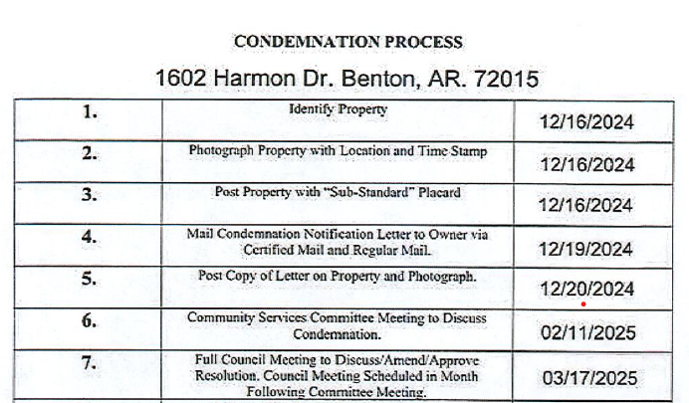
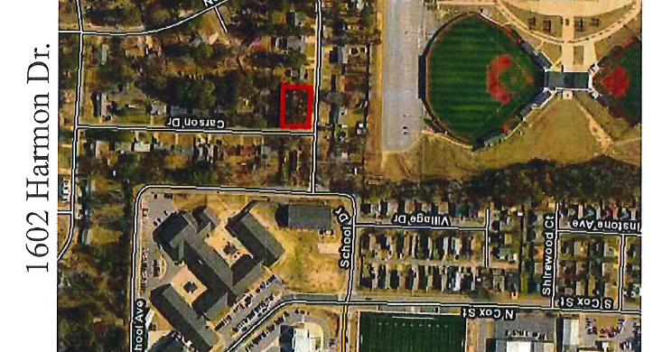
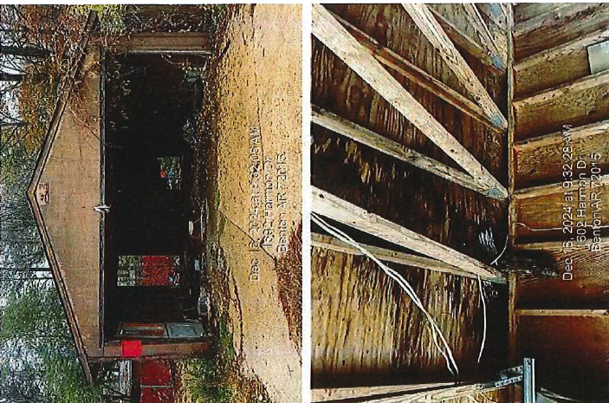
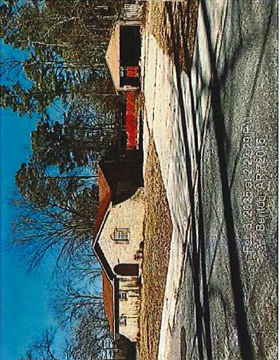
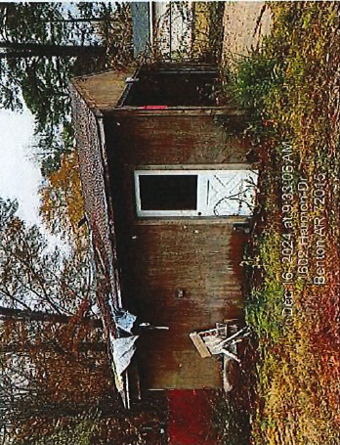

Slide 5
RESOLUTION NO. 15 OF 2025
A RESOLUTION TO CONDEMN THE STRUCTURE LOCATED AT 811 WARD DRIVE AND FOR CODE ENFORCEMENT TO RAZE SAID PROPERTY IN ACCORDANCE WITH ARKANSAS STATE LAW AND CITY ORDINANCE; AND FOR OTHER PURPOSES
WHEREAS, the structure located at 811 Ward Drive, Benton, Arkansas, (parcel 800-14277-000) has been deemed a nuisance and unfit for human habitation, unsafe, unsanitary, and detrimental to the public safety, health, and welfare by Code Enforcement Officials for the City of Benton; and
WHEREAS, the structure appears to be a white structure, which is approximately 1180 square feet; and
WHEREAS, from land documents, Randy and Judy Morrow have owned the property for an indeterminant period of time; and
WHEREAS, the structure has been inspected and issues thoroughly documented by Benton Code Enforcement, and a copy of their inspection findings is attached hereto as Exhibit 1; and
WHEREAS, after giving the owner and any mortgage or lienholder an opportunity to be heard in the presence of the City Council of the City of Benton, Arkansas, and in accordance with Ordinance No. 20 of 2021 and Arkansas State law, the City Council has determined this structure should be condemned.

Slide 6
NOW, THEREFORE, BE IT RESOLVED BY THE CITY COUNCIL OF THE CITY OF BENTON, ARKANSAS:
SECTION 1: That after said opportunity to be heard the structure located at 811 Ward Drive, Benton, Arkansas, has been condemned by vote of the City Council.
SECTION 2: That this decision is in the best interest of the public health, safety, and welfare.
SECTION 3: That it is the will of the City Council that if the structure located at 811 Ward Drive, Benton, Arkansas, has not been torn down and removed, or said nuisance otherwise abated within thirty (30) days after posting the true copy of the Resolution at a conspicuous place on said structure, then it will be torn down and/or removed by the Code Compliance Supervisor or his duly designated representative, per the authority granted by Arkansas State law and any costs of the demolition be assessed to the property owner.

Slide 7
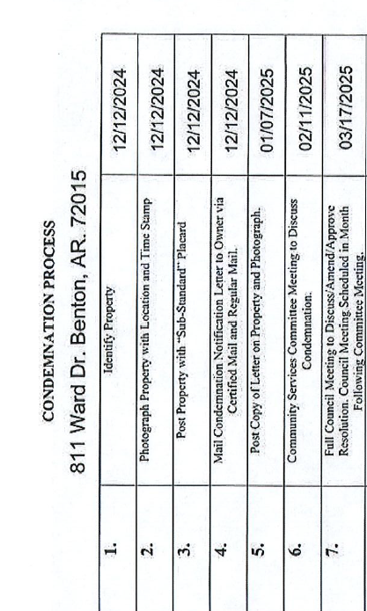
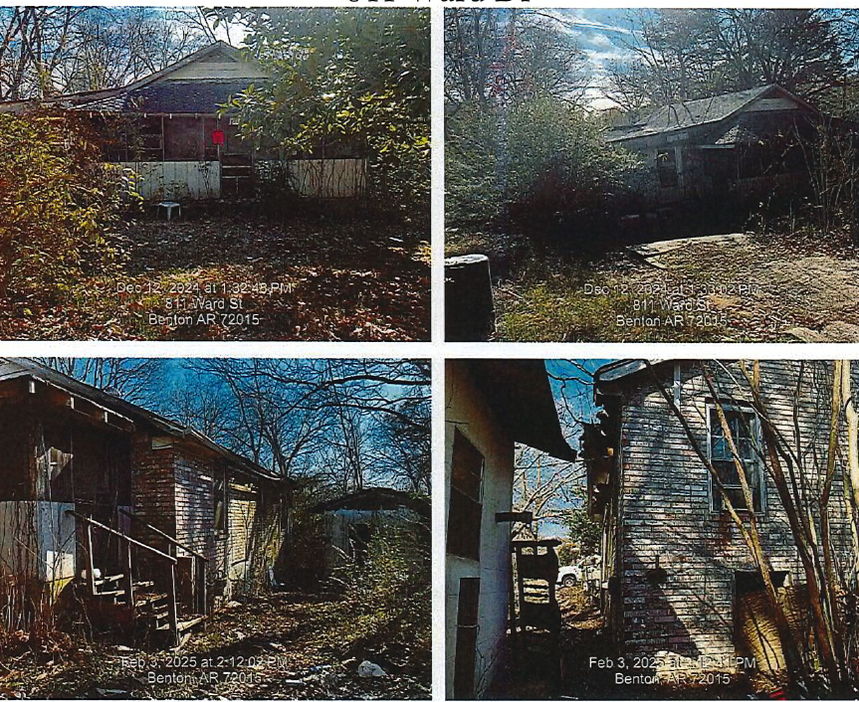

Slide 8
RESOLUTION NO. 16 OF 2025
A RESOLUTION AUTHORIZING THE CITY TO ENTER INTO A CONTRACT WITH HENRY BROWN REALTY FOR THE LEASE OF REAL PROPERTY LOCATED IN DOWNTOWN BENTON FOR THE PLACEMENT OF A FARMER'S MARKET; AND FOR OTHER PURPOSES
WHEREAS, the City Council of the City of Benton, Arkansas, has determined that it is in the best interest of the City to lease real property from Henry Brown Realty for the purpose of providing a location for a downtown farmer's market as well as a venue for public gatherings and related parking.
NOW, THEREFORE, BE IT RESOLVED BY THE CITY COUNCIL OF THE CITY OF BENTON, ARKANSAS:
SECTION 1: The Mayor and City Clerk are hereby authorized to execute, on behalf of the City, a contract with Henry Brown Realty for the lease of real property in the downtown area for the purposes stated above. The proposed contract is attached hereto as Exhibit 1. The Mayor is also authorized to pay the lease payments when due.

Slide 9
RESOLUTION NO. 17 OF 2025
A RESOLUTION AUTHORIZING THE MAYOR TO ENTER INTO AN AGREEMENT WITH THE ISAAC FREEMAN CARTER, JR LIVING TRUST FOR THE ACQUISITION OF AN EASEMENT NECESSARY FOR THE CONGO SHENANDOAH ROUNDABOUT PROJECT AND AMENDING THE 2025 STREET IMPROVEMENT BUDGET TO INCREASE THE APPROPRIATION IN THE AMOUNT OF $70,792.00 USING CASH ON HAND; AND FOR OTHER PURPOSES
WHEREAS, the City Council of the City of Benton, Arkansas, has determined that the Congo Shenandoah Roundabout project is necessary for the safe and continuous flow of traffic along Congo Road; and
WHEREAS, to complete the project, it is necessary that the City obtain title to certain property, which is described in Exhibit “1” to this Resolution; and
WHEREAS, the City caused an appraisal for the property to be completed, and through that appraisal has determined that the value of the property is $70,792; and
WHEREAS, it is the City’s desire to enter into the agreement and authorize payment of $70,792.00 to the Isaac Freeman Carter, Jr. Living Trust as just compensation for acquisition of the property; and
WHEREAS, the City of Benton, Arkansas, will use cash on hand within the Street Improvement fund for the Congo Shenandoah Roundabout Project and, therefore, requires a budget amendment.

Slide 10
NOW, THEREFORE, BE IT RESOLVED BY THE CITY COUNCIL OF THE CITY OF BENTON, ARKANSAS:
SECTION 1: The Mayor and City Clerk are hereby authorized to execute an agreement with the Isaac Freeman Carter, Jr. Living Trust for the purchase of the property. The appraisal of said property is attached hereto as Exhibit “2.”
SECTION 2: The Mayor is authorized and directed to pay the sum of $70,792 as just compensation to the Isaac Freeman Carter, Jr. Living Trust for the property.
SECTION 3: Pursuant to the authority granted in Ark. Code §§14-58-202 and 14-58-203, the City Council does amend the FY2025 City of Benton Budget as adopted in Resolution No. 142 of 2024. The budget revisions are attached hereto as Exhibit “2” to this resolution and are more fully described.

Slide 11
RESOLUTION NO. 18 OF 2025
A RESOLUTION AUTHORIZING THE MAYOR TO SPLIT THE COST OF A BI-DIRECTIONAL AMPLIFIER WITH THE BENTON SCHOOL DISTRICT AND AMENDING THE 2025 PUBLIC SAFETY BUDGET TO INCREASE THE APPROPRIATION IN THE AMOUNT OF $56,684.55 USING CASH ON HAND; AND FOR OTHER PURPOSES
WHEREAS, the City Council of the City of Benton, Arkansas has determined it is in the best interests of the City to split the cost with the Benton School District for the purchase and installation of a bi-directional amplifier for Mountainview Middle School; and
WHEREAS, the City of Benton, Arkansas, will use cash on hand within the Public Safety fund and therefore requires a budget amendment to increase the appropriation in the amount of $56,684.55.
NOW, THEREFORE, BE IT RESOLVED BY THE CITY COUNCIL OF THE CITY OF BENTON, ARKANSAS:
SECTION 1: The Mayor and City Clerk are hereby authorized to pay the sum of $56,684.55, which is half of the total cost of implementing a bi-directional amplifier to be installed at Mountainview Middle School.
SECTION 2: Pursuant to the authority granted in Ark. Code §§14-58-202 and 14-58-203, the City Council does amend the FY2025 City of Benton Budget as adopted in Resolution No. 142 of 2024. The budget revisions are attached hereto as Exhibit “1” to this resolution and are more fully described.

Slide 12
RESOLUTION NO. 19 OF 2025
A RESOLUTION PROVIDING THE MAYOR AND CITY ATTORNEY LIMITED AUTHORITY TO SETTLE LAWSUITS; AND FOR OTHER PURPOSES
WHEREAS, the City of Benton, Arkansas, from time to time is named as a party to certain lawsuits; and
WHEREAS, the City Attorney provides regular, quarterly reports on those lawsuits; and
WHEREAS, for some of those suits, it is in the City’s best interest to settle and resolve the lawsuits; and
WHEREAS, the City Council desires to give the Mayor and the City Attorney limited authority to settle and resolve lawsuits when it is in the best interest of the City.
NOW, THEREFORE, BE IT RESOLVED BY THE CITY COUNCIL OF THE CITY OF BENTON, ARKANSAS:
SECTION 1: The Mayor and City Attorney are hereby authorized to enter into and execute appropriate documents to settle any lawsuit against the City, provided the following terms have been met:

Slide 13
A. The lawsuit has been reported to the City Council through the City Attorney’s quarterly litigation report;
B. The settlement would have a final resolution of the claims against the City and any City employee acting in their capacity as a City employee;
C. In the best interest of the Mayor and City Attorney, settlement is in the best interest of the City;
D. Any payment to be made by the City can be no greater than $20,000;
E. Any such settlement must be reported within 48 hours to the City Council; and
F. All documents associated with any such settlement must be presented to the City Council at the next appropriate City Council meeting.
SECTION 2: The authority granted herein is limited by any applicable budget appropriation and is good only for the year in which this resolution is passed.

Slide 14
ORDINANCE NO. 17 OF 2025
AN ORDINANCE PERMITTING CERTAIN EMPLOYEES AND/OR THEIR RELATIVES TO CONDUCT BUSINESS WITH THE CITY OF BENTON, ARKANSAS, AND PRESCRIBING THE EXTENT OF SUCH AUTHORITY; AND FOR OTHER PURPOSES
WHEREAS, it has been recommended by the Bureau of Legislative Audit that the City adopt an ordinance that allows employees who also provide other services that are beyond the scope of their employment, and/or the employee’s relative to conduct business with the City; and
WHEREAS, but for the adoption of this Ordinance, Arkansas Code Section §14-42-107 would prohibit the City from purchasing or otherwise obtaining these part-time services from the employees and/or their relatives named herein; and
WHEREAS, the City Council finds it is in the best interest of the City to do business with the employees and/or their relatives named herein, and the services provided.
NOW, THEREFORE, BE IT ORDAINED BY THE CITY COUNCIL OF THE CITY OF BENTON, ARKANSAS:
SECTION 1: The employees listed in the attached Exhibit 1 shall be permitted to conduct business and to furnish such services to the City to the full extent that he or she could have conducted business with the City of Benton, but for the effect of Arkansas Code Section §14-42-107 prior to the adoption of this Ordinance.

Slide 15
ORDINANCE NO. 18 OF 2025
AN ORDINANCE MODIFYING THE CITY OF BENTON PAY STRUCTURE FOR ALL GENERAL FUND, STREET, ANIMAL SERVICES, AND PARKS DEPARTMENT OFFICIALS & EMPLOYEES; AND FOR OTHER PURPOSES
WHEREAS, the City Council of the City of Benton, Arkansas, has determined that it is in the best interest of the City to revise and update the wage structure for 2025.
NOW, THEREFORE, BE IT ORDAINED BY THE CITY COUNCIL OF THE CITY OF BENTON, ARKANSAS:
SECTION 1: The City does hereby adopt the wage structure set out in Exhibit 1 attached hereto and incorporated herein as if stated word for word.
SECTION 2: If any provisions of this ordinance or the application thereof to any person or circumstance is held invalid, such invalidity shall not impact the other provisions or applications, and to this end, the provisions of this ordinance are hereby declared to be severable. All ordinances in conflict herewith are repealed to the extent of the conflict but not otherwise, including Ordinance No. 97 of 2019, Ordinance No. 70 of 2020, Ordinance No. 9 of 2022, Ordinance No. 17 of 2023, Ordinance No. 26 of 2023, Ordinance 45 of 2023, Ordinance 20 of 2024, and Ordinance 32 of 2024.

Slide 16
ORDINANCE NO. 19 OF 2025
AN ORDINANCE REZONING 704 BIRD STREET IN THE CITY OF BENTON, SALINE COUNTY, ARKANSAS, FROM R7 MULTI FAMILY RESIDENTIAL DISTRICT TO R8 MULTI FAMILY RESIDENTIAL DISTRICT; AND FOR OTHER PURPOSES
WHEREAS, an application for rezoning was filed with the Planning Commission of the City of Benton, Arkansas, requesting that the property located at 704 Bird Street in the City of Benton, Arkansas, be rezoned from R7 to R8; and
WHEREAS, the Planning Commission ordered a public hearing be held on March 4, 2025, at 6:00 p.m., for the purpose of hearing said application; the notice of such hearing having been published in a newspaper having a bona fide circulation in Saline County, Arkansas, with evidence having been submitted that all property owners or lessees within 300 feet of the property having been notified of said hearing; and at said hearing, the Planning Commission recommended to the City Council that such request be granted; and
WHEREAS, the City Council has determined that it is in the best interest of the City to rezone the following property from R7 to R8.
NOW, THEREFORE, BE IT ORDAINED BY THE CITY COUNCIL OF THE CITY OF BENTON, ARKANSAS:
SECTION 1: The following described property is hereby rezoned from R7 Multi Family Residential District to R8 Multi Family Residential District.
Address: 704 Bird Street Benton, AR 72015
Parcel Number #805-21399-000

Slide 17
ORDINANCE NO. 15 OF 2025
AN ORDINANCE ESTABLISHING ELECTRICAL RATES FOR CUSTOMERS OF THE CITY OF BENTON, ARKANSAS; REPEALING ELECTRICAL RATE STRUCTURES ADOPTED BY THE CITY IN ORDINANCE NO. 59 OF 2022; AND FOR OTHER PURPOSES
WHEREAS, Ordinance No. 46 of 2004 and Arkansas Code, the City Council of the City of Benton, Arkansas has the authority to set rates for the Utility: and
WHEREAS, the rates' structure set forth herein are reasonable and necessary for the continued operations of the Utility for the reasons set forth herein; and
WHEREAS, the prior rate structures for the City were established in previous ordinances that now must be repealed.
NOW, THEREFORE, BE IT ORDAINED BY THE CITY COUNCIL OF THE CITY OF BENTON, ARKANSAS:
SECTION 1: The retail rates for electric service set by Benton Utilities made part of this ordinance as Exhibit 1 are adopted as the rates to be charged in the City of Benton, Arkansas, as fair and equitable for electric services. These rates shall become effective with billing on or after June 1, 2025.

Slide 18
RESOLUTION NO. 20 OF 2025
A RESOLUTION NAMING THE SECOND STREET BRIDGE “CPL CARIO FULLER, JR.” BRIDGE IN RECOGNITION OF CPL FULLER’S SERVICE AND SACRIFICE ON BEHALF OF OUR COUNTRY; AND FOR OTHER PURPOSES
WHEREAS, CPL Cario Fuller, Jr., was born on March 5, 1947, and grew up in the Ralph Bunche Community, on Dixie Street in Benton, Arkansas. At the age of 19, CPL Cario Fuller, Jr. enlisted in the United States Army and began his tour on August 10, 1966, as an Infantry Indirect Fire Crewman for the 1st Cavalry Division, 1st Battalion, 12th Cavalry, B Company under service number assignment 18750583; and
WHEREAS, CPL Cario Fuller, Jr. was serving his country during the Vietnam War when he gave his all in the line of duty on April 9, 1967, through hostile action, small arms fire in South Vietnam, Binh Dinh province. CPL Fuller is a Purple Heart recipient and is a Vietnam War Gold Star Veteran in Arkansas. Other commendations and awards include Combat Infantryman Badge, National Defense Service Metal, Vietnam Campaign Medal, Vietnam Service Metal, Army Presidential Unit Citation, and Vietnam Gallantry Cross; and
WHEREAS, CPL Cario Fuller, Jr. is honored on the Vietnam Veteran’s Memorial in Washington DC. Name inscribed at VVM Wall, Panel 18e, Line 3; and
WHEREAS, in honor of these services the City Council of the City of Benton, Arkansas, wishes to name the Second Street Bridge in his memory.
NOW, THEREFORE, BE IT RESOLVED BY THE CITY COUNCIL OF THE CITY OF BENTON, ARKANSAS:
SECTION 1: The Second Street Bridge shall be named “CPL Cario Fuller, Jr. Bridge”, with appropriate signage and/or markers to be placed for this purpose.

Slide 19
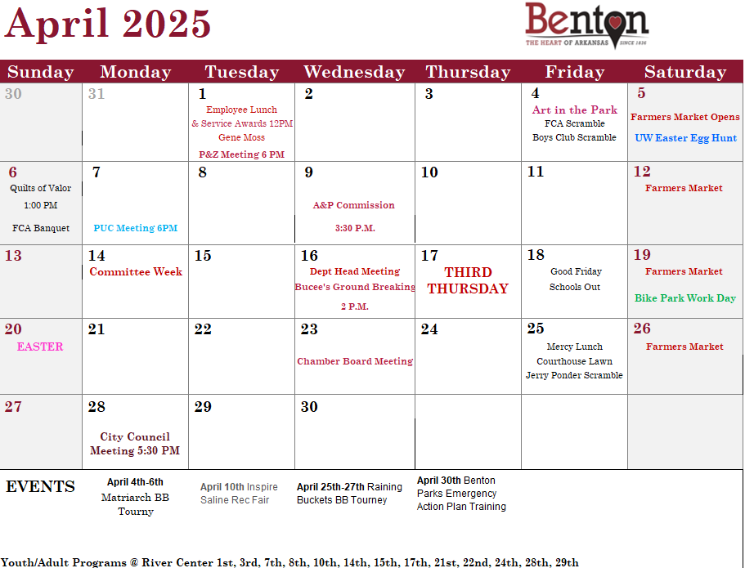

Slide 20
