Slide 1
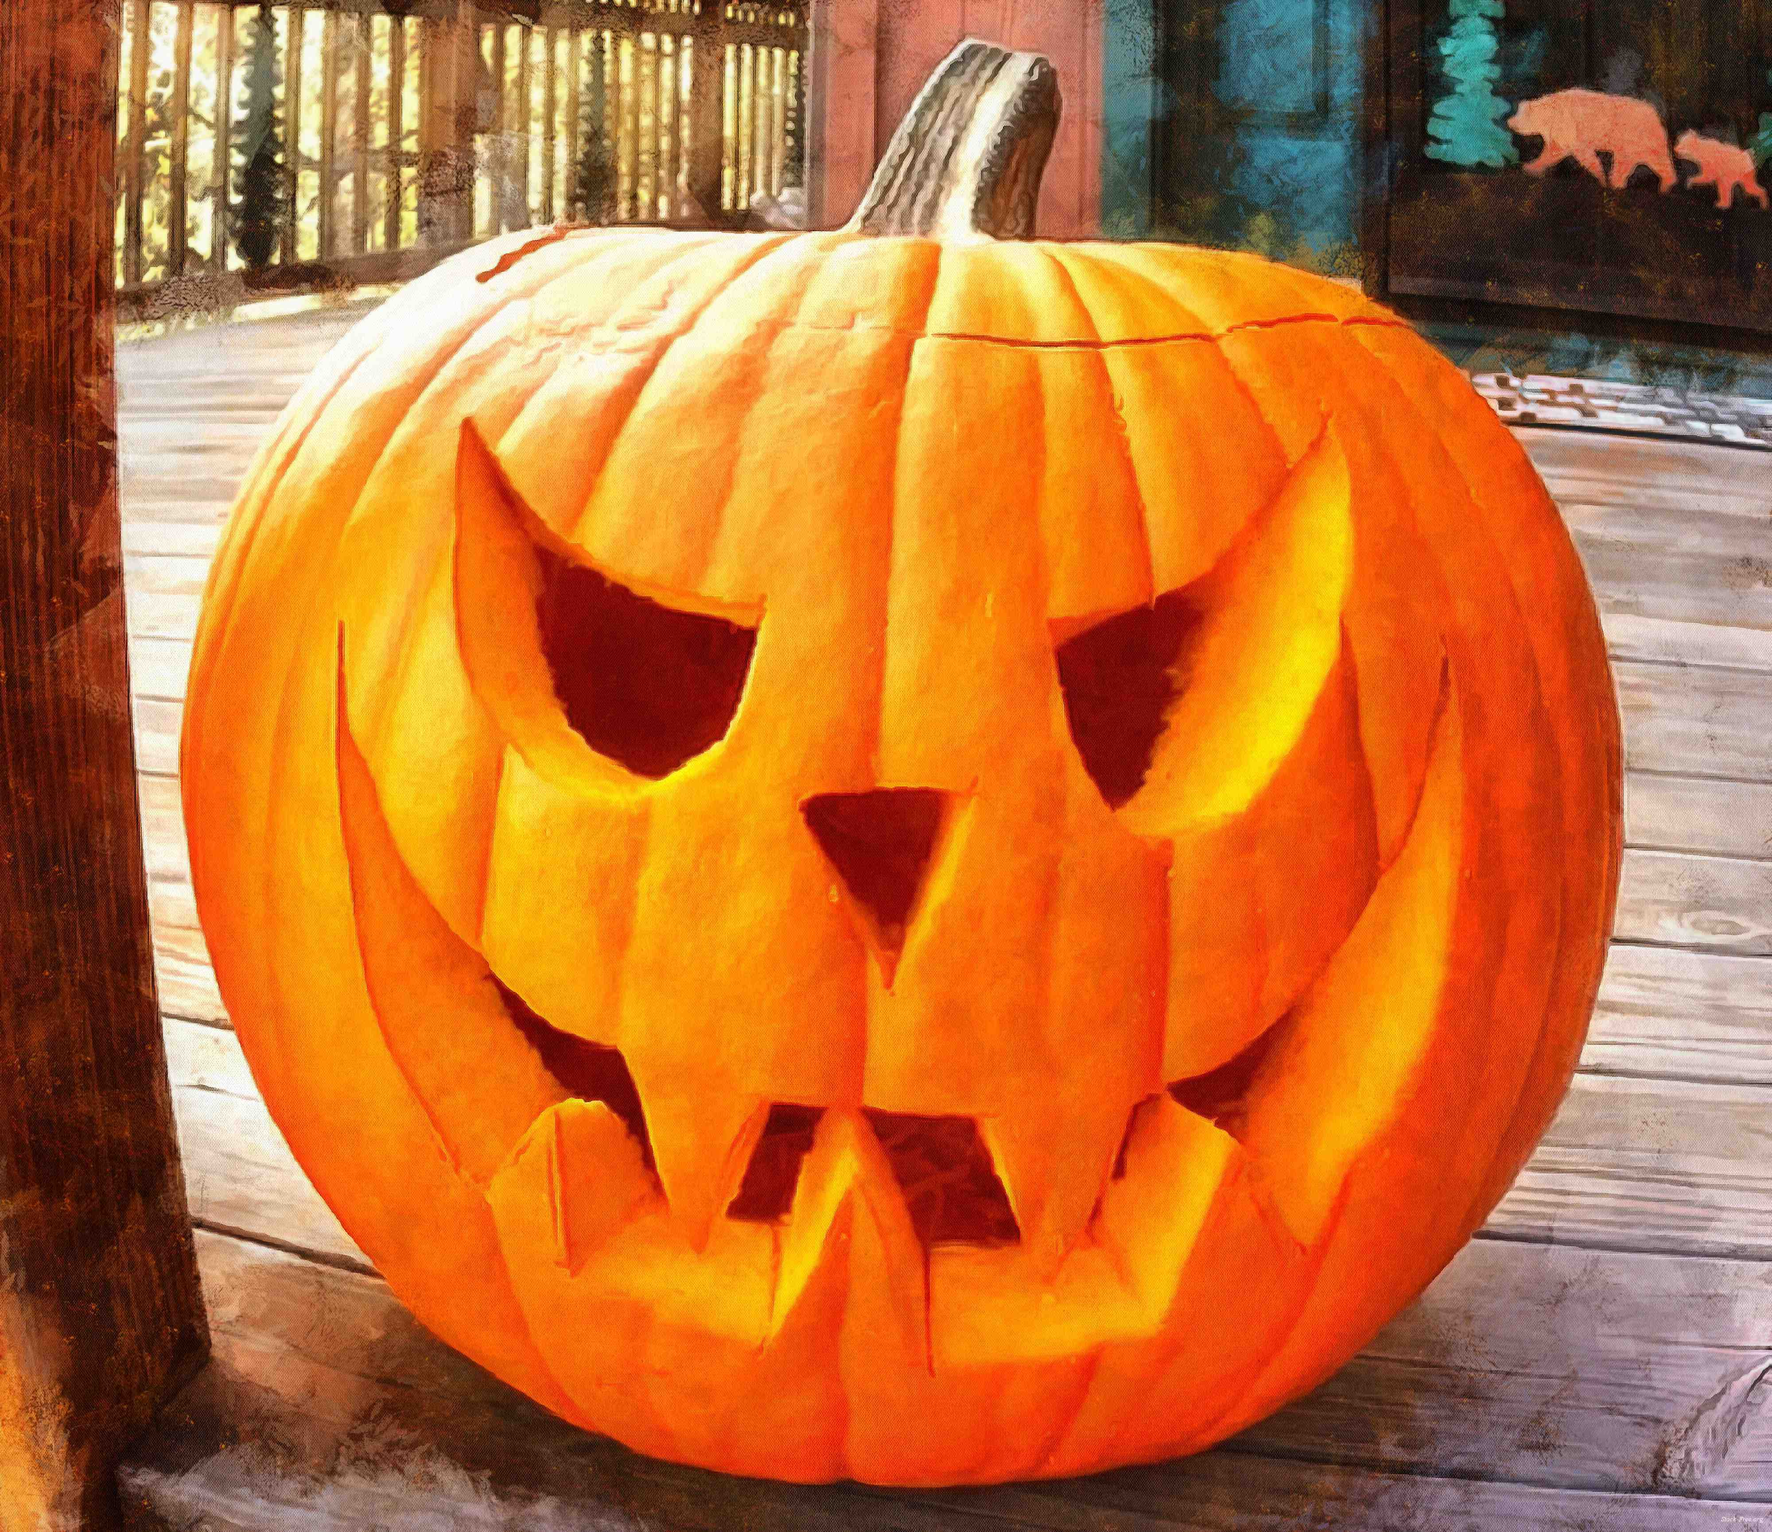
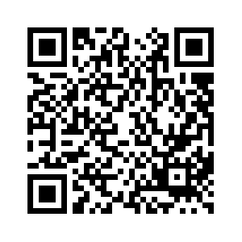
Newtown Library’s 2023 Halloween Scavenger Hunt:
A Fun-Filled Weekend for All Ages!
Oct 21-22
$25 per team
All proceeds benefit the Newtown Library Company, a non-profit organization run by a wonderful community of volunteers.
EVENT DETAILS:
Teams receive their packet via email at 9 am on Saturday, 10/21.
The packet includes two lists of items to find and photograph, including 10 “Pumpkin” locations in Newtown.
To compete for prizes, turn in your packet at Starbucks on State St. at 2pm on Sunday, 10/22.
The 3 teams that find the most items win prizes!
Goodie bags will be given at the judging to all children ages 0-13.

